Slide 1
Top-Down Parsing
Lecture 7
Section 4.4
Rokan Uddin Faruqui
Associate Professor
Dept of Computer Science and Engineering University of Chittaong, Bangladesh Email: rokan@cu.ac.bd

Slide 2









Left Factoring
Nullability
E —>TE’
E’—>+TE’ | epsilon
1
2
E —> E + T | T
The FIRST Function
The FOLLOW Function
The Parse Table Entries
The Parse Table
Predictive Parsing
Assignment
3
S —> AA’
A’ —> b | c
Top-Down Parsing
2

Slide 3








Outline
Left Factoring
1
Left Factoring
Nullability
2
The FIRST Function
The FOLLOW Function
The Parse Table Entries
6
The Parse Table
Predictive Parsing
7
8 Assignment
Top-Down Parsing

Slide 4
Left Factoring
Left Factoring
A problem occurs when two productions for the same nonterminal begin with the same token.
We cannot decide which production to use.
This is not necessarily a problem since we could process the part they have in common, then make a decision based on what follows.
Top-Down Parsing

Slide 5
Left Factoring
Left Factoring
Consider the grammar
A → αβ | αγ
We use left factorization to transform it into the form
A → αA′ A′ → β | γ.
Now we can apply the productions immediately and unambiguously.
Top-Down Parsing

Slide 6
Example
Left Factoring
Example (Left Factoring)
In the earlier example, we had the productions
C → id == num | id != num | id < num
To perform left factoring, introduce a nonterminal C′:
C → id C′
C′ → == num | != num | < num
Top-Down Parsing

Slide 7
Example
Left Factoring
Example (Left Factoring)
Consider the grammar of if statements.
S → if C then S else S
| if C then S
We rewrite it as
S → if C then S S′
S′ → else S | ε
Top-Down Parsing

Slide 8


Outline
Nullability
1
Left Factoring
Nullability
2
The FIRST Function
The FOLLOW Function
The Parse Table Entries
6
The Parse Table
Predictive Parsing
7
8 Assignment
Top-Down Parsing

Slide 9
Table-Driven LL Parsing
Nullability
To build the parsing table, we need three concepts:
Nullability
The FIRST function The FOLLOW function
Top-Down Parsing

Slide 10
Nullability
Nullability
E’ —> +TE’ E’ —> e
Definition (Nullable)
A nonterminal A is nullable if
∗
A ⇒ ε.
Top-Down Parsing

Slide 11
Nullability
B => e
C => B => e
C =>* e
A => BC => C => e
A =>* e
Nullability
Example (Nullability)
In the following grammar, A, B, and C are nullable.
A → B C
B → A | a C | ε
C → a B | B A | B
Top-Down Parsing

Slide 12
Nullability
Nullability
In other words, A is nullable if there is a production
A → ε,
or there is a production
A → B₁ B₂ . . . B_{n},
where B₁, B₂, …, B_{n} are nullable.
Top-Down Parsing

Slide 13
Example
Nullability
E —> E + E — ambigous E —> E + T | T
Example (Nullability)
In the grammar
T—> T *F| F
F —> (E) |id — unambigous but left reciursive
E → T E′
E′ → + T E′ | ε T → F T ′
T ′ → * F T ′ | ε F → ( E ) | id
E—> TE’|
E′ and T ′ are nullable.
E, T , and F are not nullable.
Top-Down Parsing

Slide 14
Nullability
Example
Example (Nullability)
Nonterminal | Nullable
E | No
_{E}′ | Yes
T | No
_{T} ′ | Yes
F | No
Top-Down Parsing

Slide 15
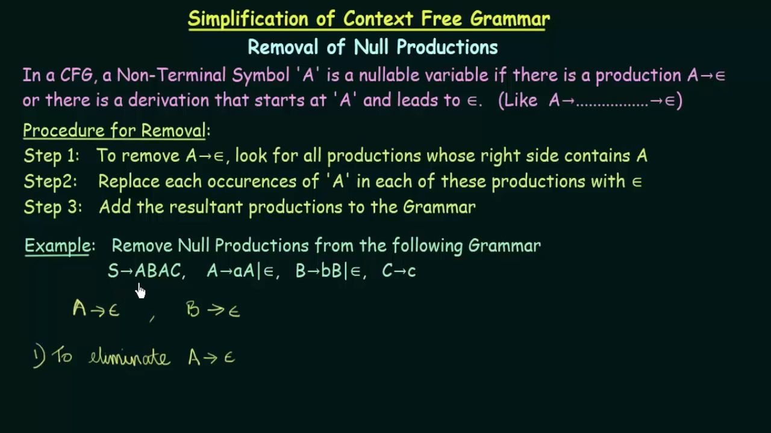

Slide 16
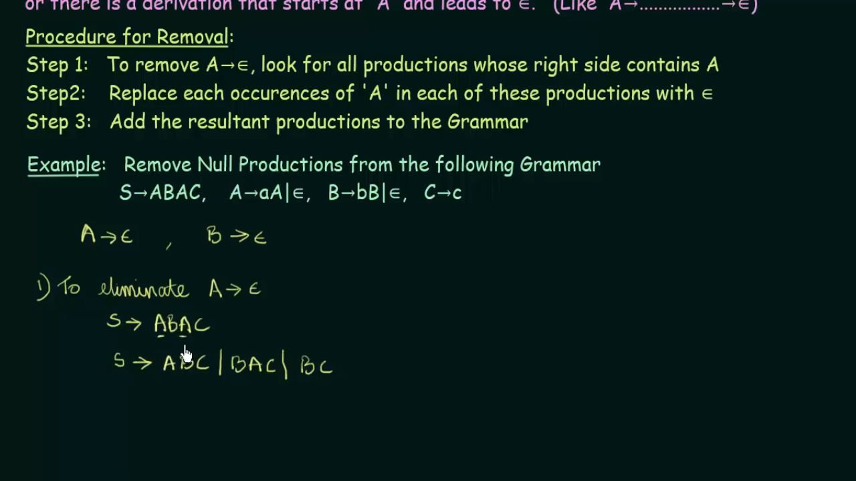

Slide 17
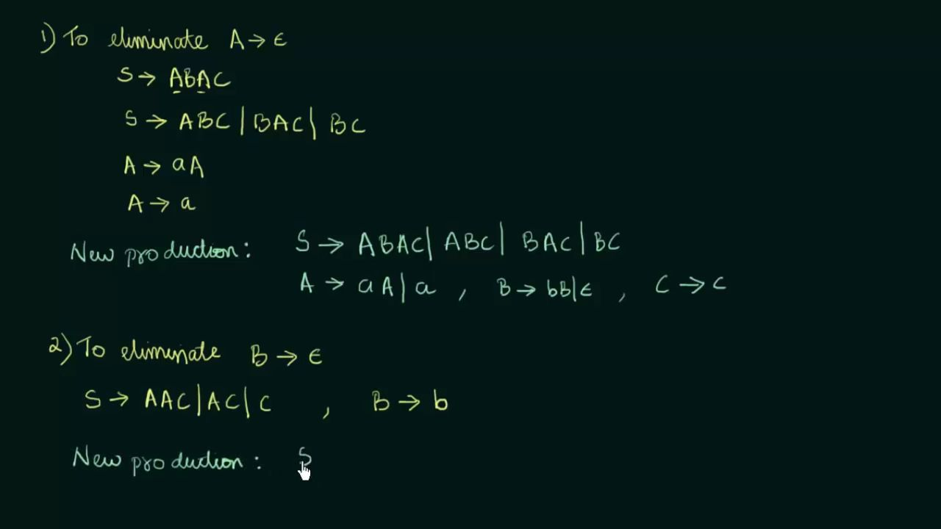

Slide 18
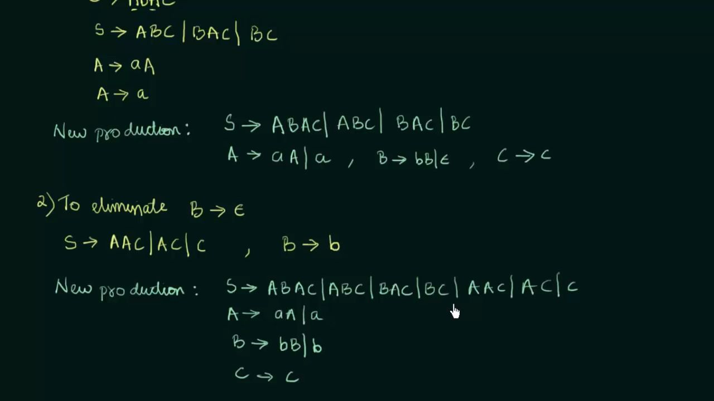

Slide 19

Outline
The FIRST Function
1
Left Factoring
Nullability
2
The FIRST Function
The FOLLOW Function
The Parse Table Entries
6
The Parse Table
Predictive Parsing
7
8 Assignment
Top-Down Parsing

Slide 20
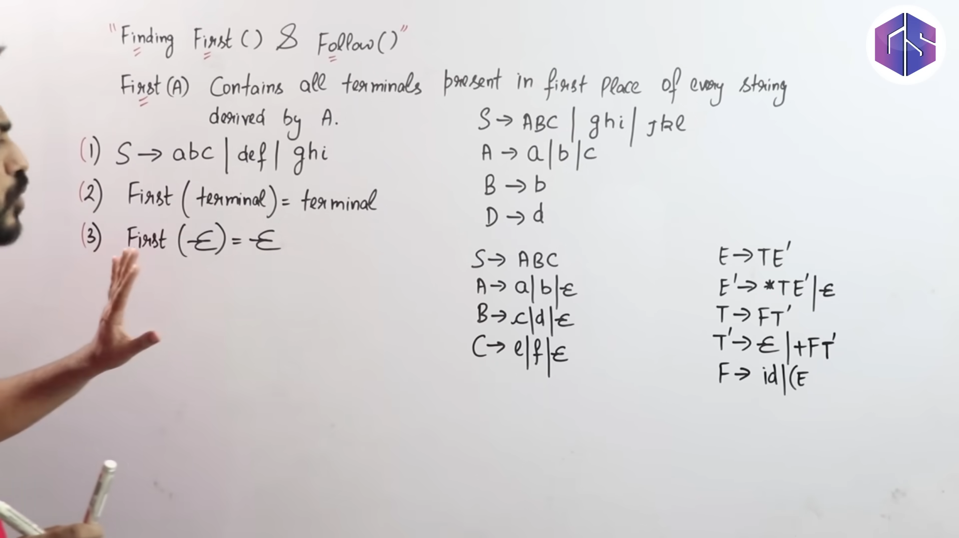

Slide 21
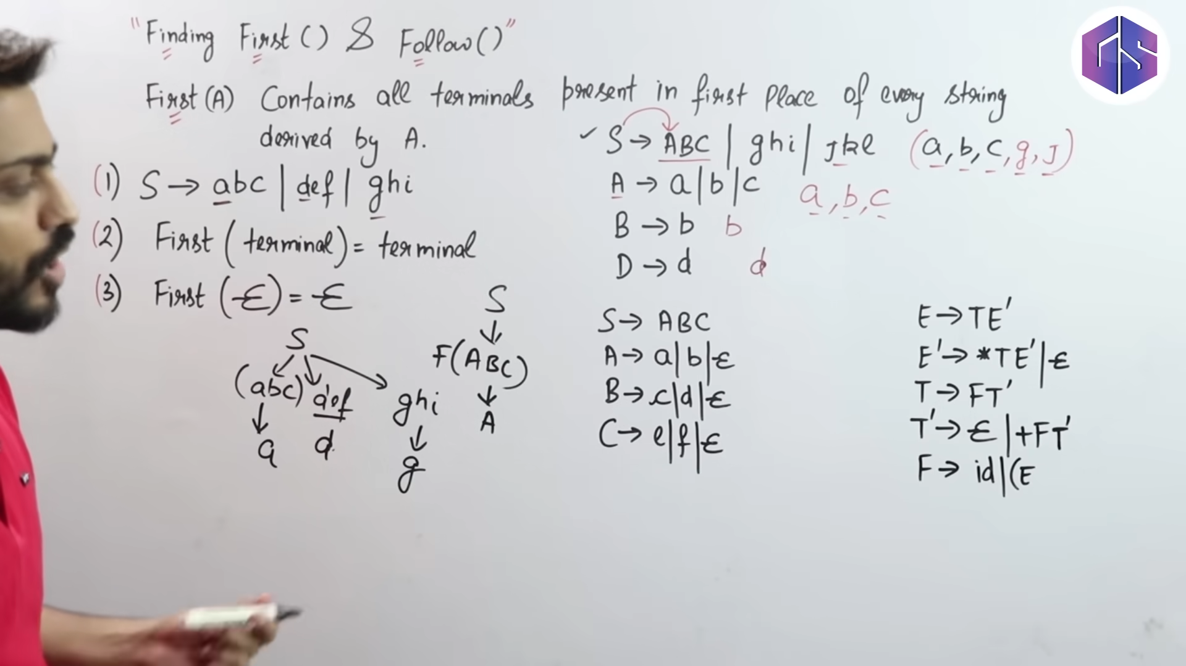

Slide 22
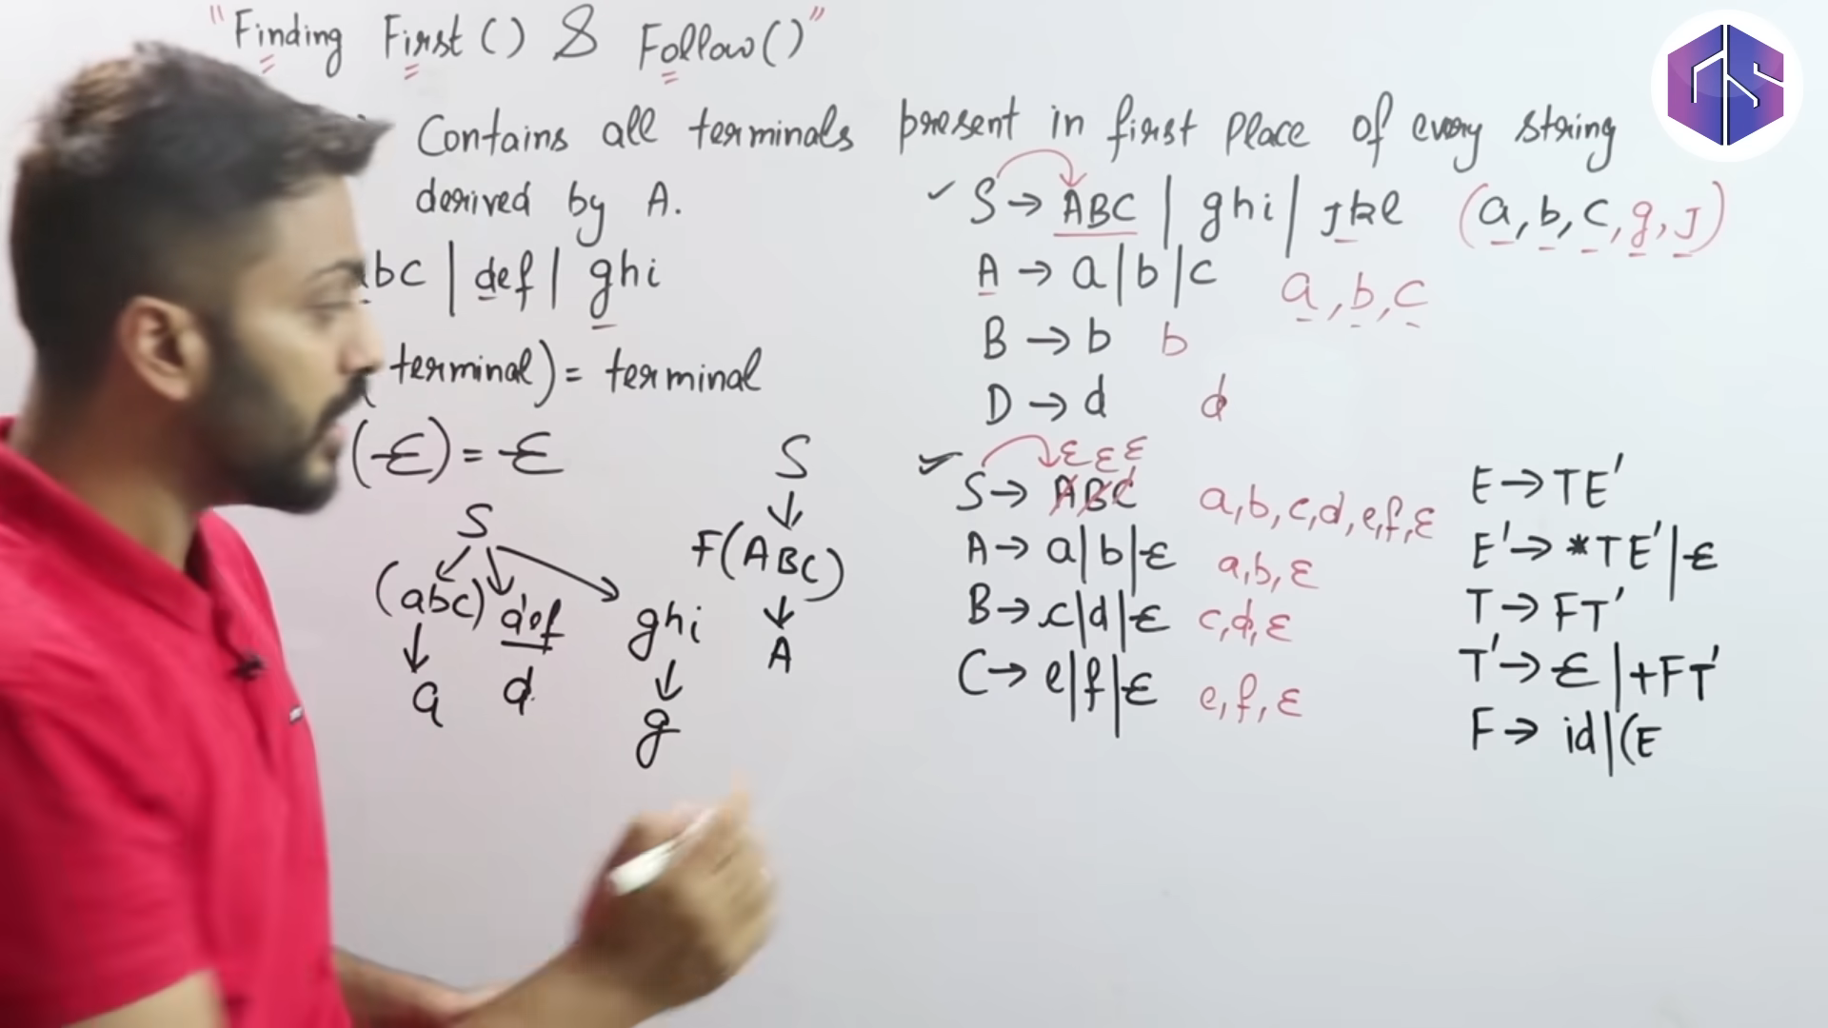

Slide 23
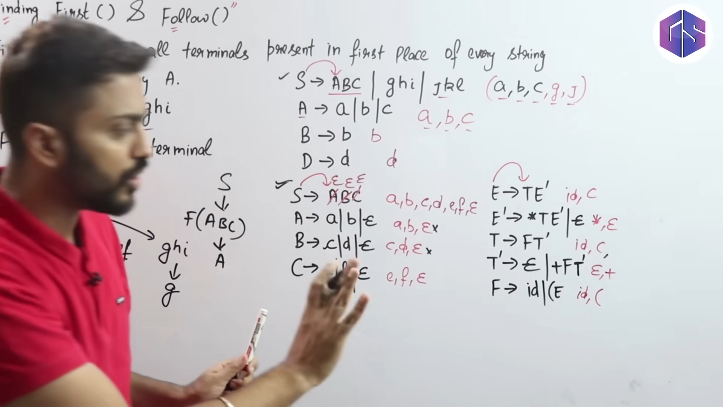

Slide 24
Lec-8: LL(1) Parsing Table | Check Whether a Grammar is LL(1) or Not

Slide 31
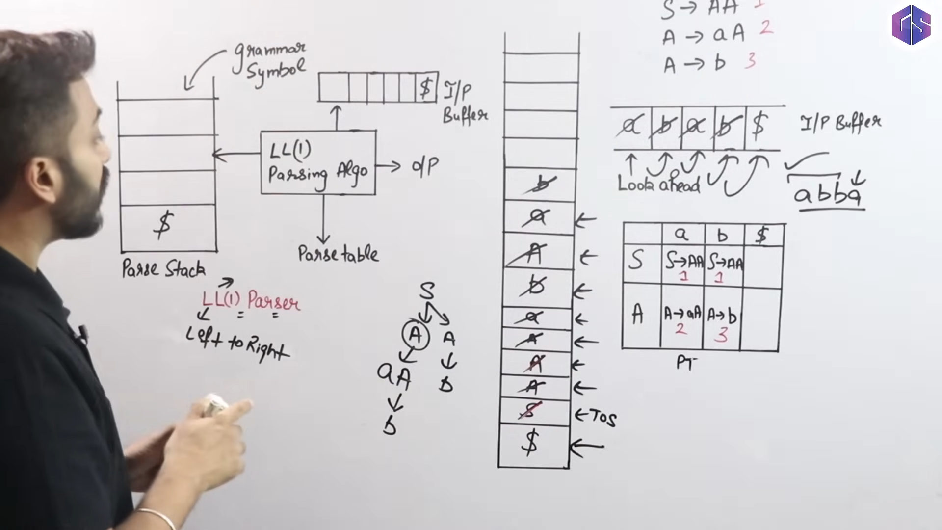
Lec-10: What is LL(1) Parser | How it Works | Full Concept

Slide 32
The FIRST Function
The FIRST Function
id1 + (id2 * id3)
Definition (The FIRST Function)
For any string of grammar symbols α, FIRST(α) is the set of all tokens that may appear as the first symbol in a replacement string of α.
Top-Down Parsing

Slide 33
Computing FIRST(X)
The FIRST Function
Computing FIRST(X)
Let X be a grammar symbol. FIRST(X) is computed as follows.
If X is a token, then FIRST(X) = {X}.
If X is a nonterminal, then for every production
X → Y₁ Y₂ . . . Y_{n},
FIRST(Y1) ⊆ FIRST(X).
Furthermore, if Y1, Y2, …, Yk are nullable, then
FIRST(Yk+1) ⊆ FIRST(X).
Top-Down Parsing

Slide 34
FIRST
The FIRST Function
We are concerned with FIRST(X) only for the nonterminals of the grammar.
FIRST(X) for terminals is trivial.
According to the definition, to determine FIRST(A), we must inspect all productions that have A as their head.
Top-Down Parsing

Slide 35


Example
The FIRST Function
FIRST(E) = FIRST(T) = FIRST(F) = {(, id}
FIRST(E’) = {+, e } —nullable FIRST(T’) = {*, e} — nullable
Example (FIRST)
A —> BCD
Let the grammar be
FIRST(A) = FIRST(D) if both B and C are nullable
FOLLOW(T) = { + , $, )}
FOLLOW(E’) = { $, )}
FOLLOW(T’)=FOLL(T) FOLLOW(F)={*,+,$,)}
E → T E′
E′ → + T E′ |ε
T → F T ′
T ′ → * F T ′ | ε F → ( E ) | id
Top-Down Parsing

Slide 36
Example
The FIRST Function
Example (FIRST) Find FIRST(E).
E occurs as the head in only one production
E → T E′
Therefore,
FIRST(T ) ⊆ FIRST(E).
Furthermore, T is not nullable. Therefore,
FIRST(E) = FIRST(T ).
We have yet to determine FIRST(T ).
Top-Down Parsing

Slide 37
Example
The FIRST Function
Example (FIRST) Find FIRST(E).
E occurs as the head in only one production
E → T E′
Therefore,
FIRST(T ) ⊆ FIRST(E).
Furthermore, T is not nullable. Therefore,
FIRST(E) = FIRST(T ).
We have yet to determine FIRST(T ).
Top-Down Parsing

Slide 38
Example
The FIRST Function
Example (FIRST) Find FIRST(E).
E occurs as the head in only one production
E → T E′
Therefore,
FIRST(T ) ⊆ FIRST(E).
Furthermore, T is not nullable. Therefore,
FIRST(E) = FIRST(T ).
We have yet to determine FIRST(T ).
Top-Down Parsing

Slide 39
Example
The FIRST Function
Example (FIRST) Find FIRST(E).
E occurs as the head in only one production
E → T E′
Therefore,
FIRST(T ) ⊆ FIRST(E).
Furthermore, T is not nullable. Therefore,
FIRST(E) = FIRST(T ).
We have yet to determine FIRST(T ).
Top-Down Parsing

Slide 40
Example
The FIRST Function
Example (FIRST) Find FIRST(E).
E occurs as the head in only one production
E → T E′
Therefore,
FIRST(T ) ⊆ FIRST(E).
Furthermore, T is not nullable. Therefore,
FIRST(E) = FIRST(T ).
We have yet to determine FIRST(T ).
Top-Down Parsing

Slide 41
Example
The FIRST Function
Example (FIRST) Find FIRST(T ).
T occurs as the head in only one production
T → F T ′
Therefore,
FIRST(F ) ⊆ FIRST(T ).
Furthermore, F is not nullable. Therefore,
FIRST(T ) = FIRST(F ).
We have yet to determine FIRST(F ).
Top-Down Parsing

Slide 42
Example
The FIRST Function
Example (FIRST) Find FIRST(T ).
T occurs as the head in only one production
T → F T ′
Therefore,
FIRST(F ) ⊆ FIRST(T ).
Furthermore, F is not nullable. Therefore,
FIRST(T ) = FIRST(F ).
We have yet to determine FIRST(F ).
Top-Down Parsing

Slide 43
Example
The FIRST Function
Example (FIRST) Find FIRST(T ).
T occurs as the head in only one production
T → F T ′
Therefore,
FIRST(F ) ⊆ FIRST(T ).
Furthermore, F is not nullable. Therefore,
FIRST(T ) = FIRST(F ).
We have yet to determine FIRST(F ).
Top-Down Parsing

Slide 44
Example
The FIRST Function
Example (FIRST) Find FIRST(T ).
T occurs as the head in only one production
T → F T ′
Therefore,
FIRST(F ) ⊆ FIRST(T ).
Furthermore, F is not nullable. Therefore,
FIRST(T ) = FIRST(F ).
We have yet to determine FIRST(F ).
Top-Down Parsing

Slide 45
Example
The FIRST Function
Example (FIRST) Find FIRST(T ).
T occurs as the head in only one production
T → F T ′
Therefore,
FIRST(F ) ⊆ FIRST(T ).
Furthermore, F is not nullable. Therefore,
FIRST(T ) = FIRST(F ).
We have yet to determine FIRST(F ).
Top-Down Parsing

Slide 46
Example
The FIRST Function
Example (FIRST) Find FIRST(F ).
FIRST(F ) = {(, id}.
Therefore,
FIRST(E) = {(, id}.
FIRST(T ) = {(, id}.
Top-Down Parsing

Slide 47
Example
The FIRST Function
Example (FIRST) Find FIRST(F ).
FIRST(F ) = {(, id}.
Therefore,
FIRST(E) = {(, id}.
FIRST(T ) = {(, id}.
Top-Down Parsing

Slide 48
Example
The FIRST Function
Example (FIRST) Find FIRST(F ).
FIRST(F ) = {(, id}.
Therefore,
FIRST(E) = {(, id}.
FIRST(T ) = {(, id}.
Top-Down Parsing

Slide 49
Example
The FIRST Function
Example (FIRST) Find FIRST(E′).
FIRST(E′) = {+}.
Find FIRST(T ′).
FIRST(T′) = {*}.
Top-Down Parsing

Slide 50
Example
The FIRST Function
Example (FIRST) Find FIRST(E′).
FIRST(E′) = {+}.
Find FIRST(T ′).
FIRST(T′) = {*}.
Top-Down Parsing

Slide 51
Example
The FIRST Function
Example (FIRST) Find FIRST(E′).
FIRST(E′) = {+}.
Find FIRST(T ′).
FIRST(T′) = {*}.
Top-Down Parsing

Slide 52
Example
The FIRST Function
Example (FIRST) Find FIRST(E′).
FIRST(E′) = {+}.
Find FIRST(T ′).
FIRST(T′) = {*}.
Top-Down Parsing

Slide 53
The FIRST Function
Example
Example (FIRST)
Nonterminal | Nullable | FIRST
E | No | {(, id}
_{E}′ | Yes | {+}
T | No | {(, id}
_{T} ′ | Yes | {*}
F | No | {(, id}
Top-Down Parsing

Slide 54
Example
The FIRST Function
Example (FOLLOW) The grammar
R → R ∪ R | R R | R * | ( R ) | id
generates all regular expressions over a set of identifiers. Find FIRST(X) for each nonterminal X.
Top-Down Parsing

Slide 55
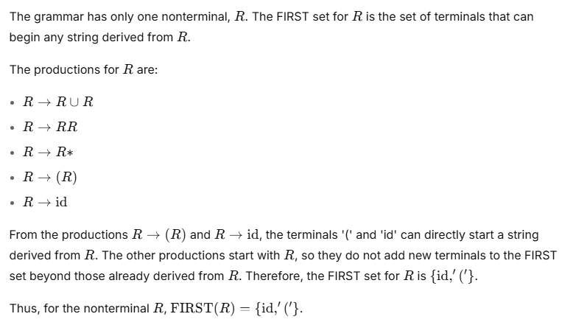

Slide 56

Outline
The FOLLOW Function
1
Left Factoring
Nullability
2
The FIRST Function
The FOLLOW Function
The Parse Table Entries
6
The Parse Table
Predictive Parsing
7
8 Assignment
Top-Down Parsing

Slide 57
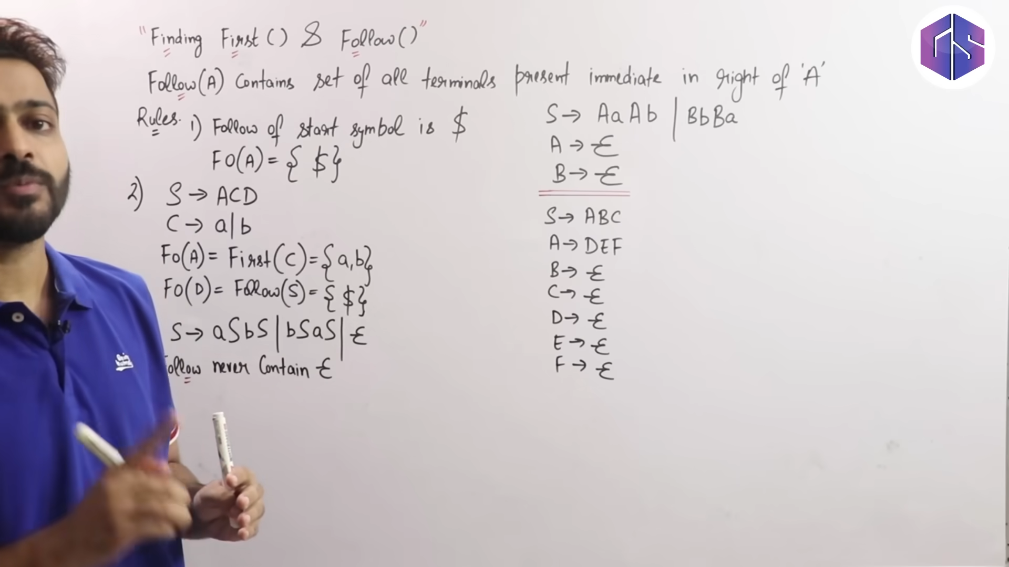

Slide 58
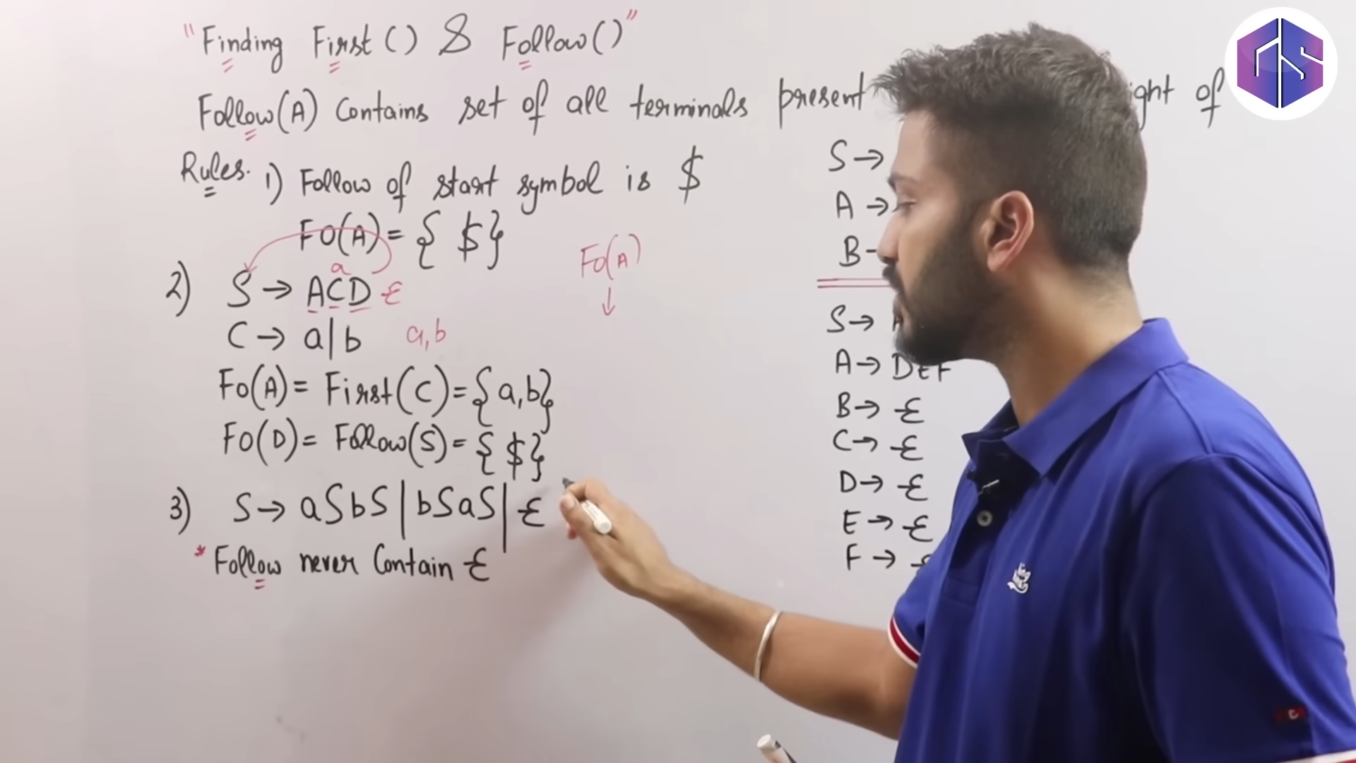

Slide 59
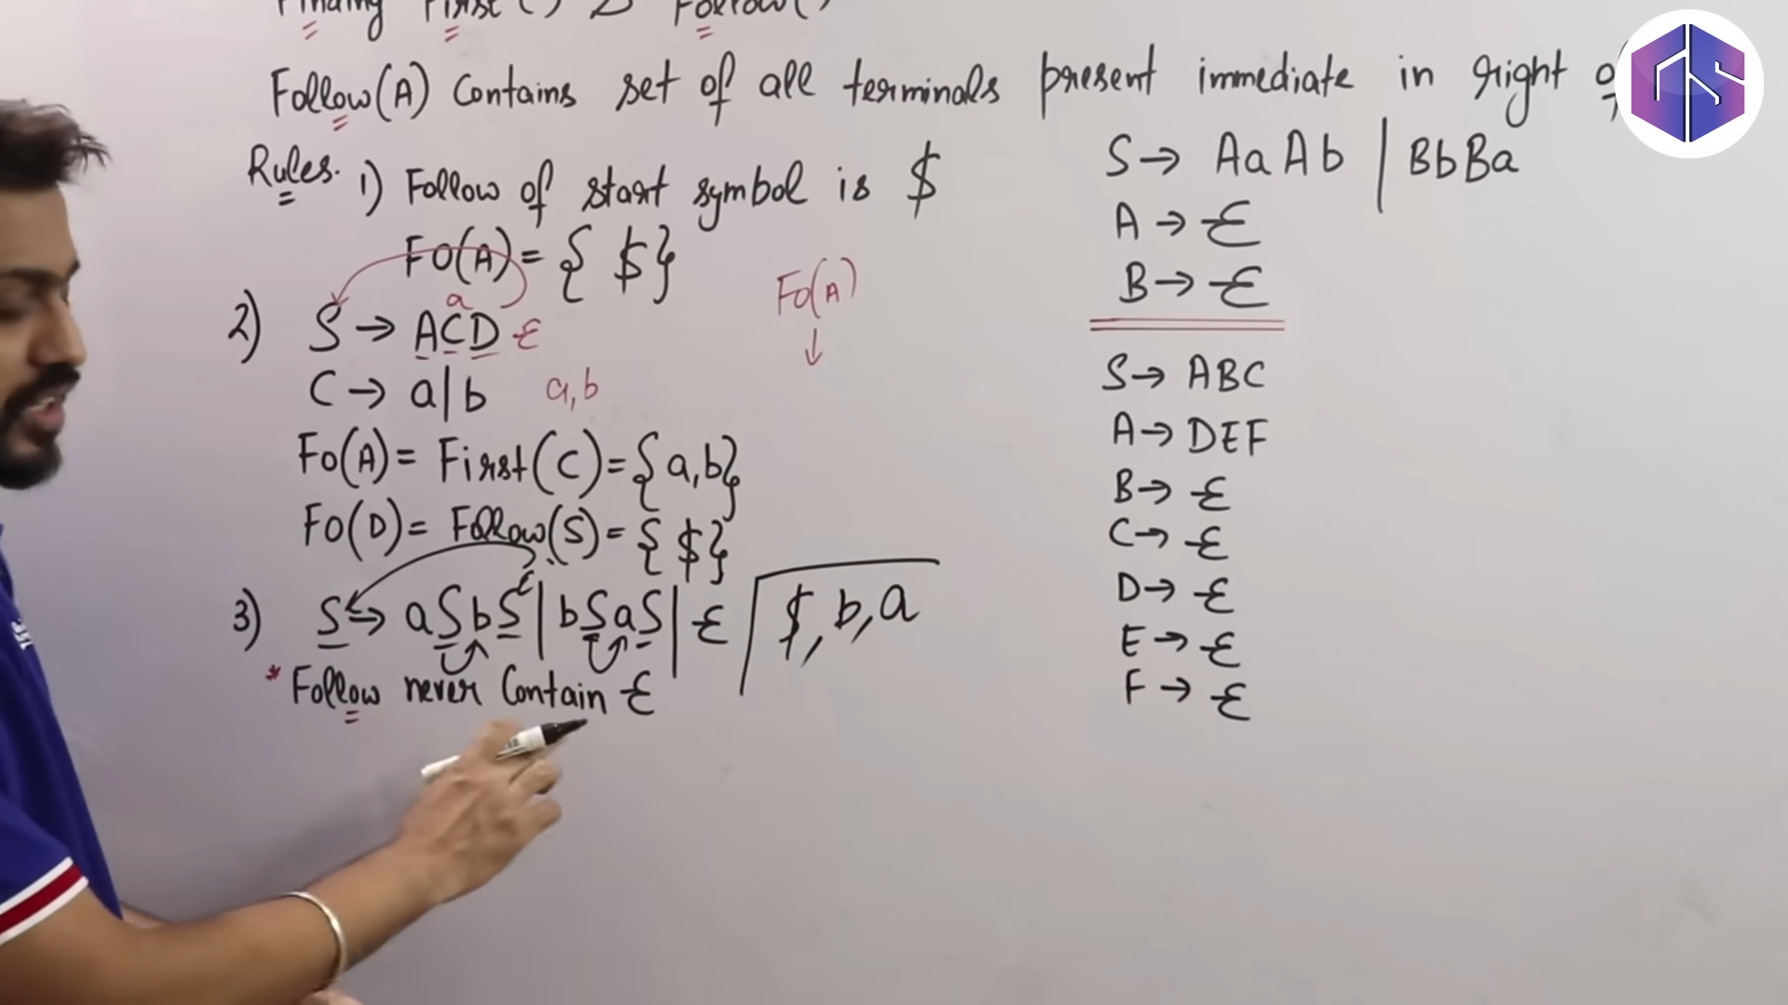

Slide 60
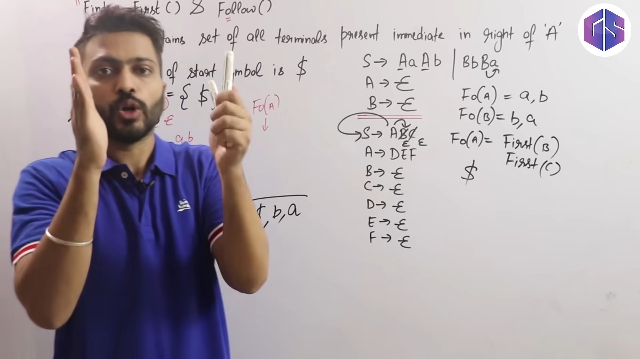

Slide 61
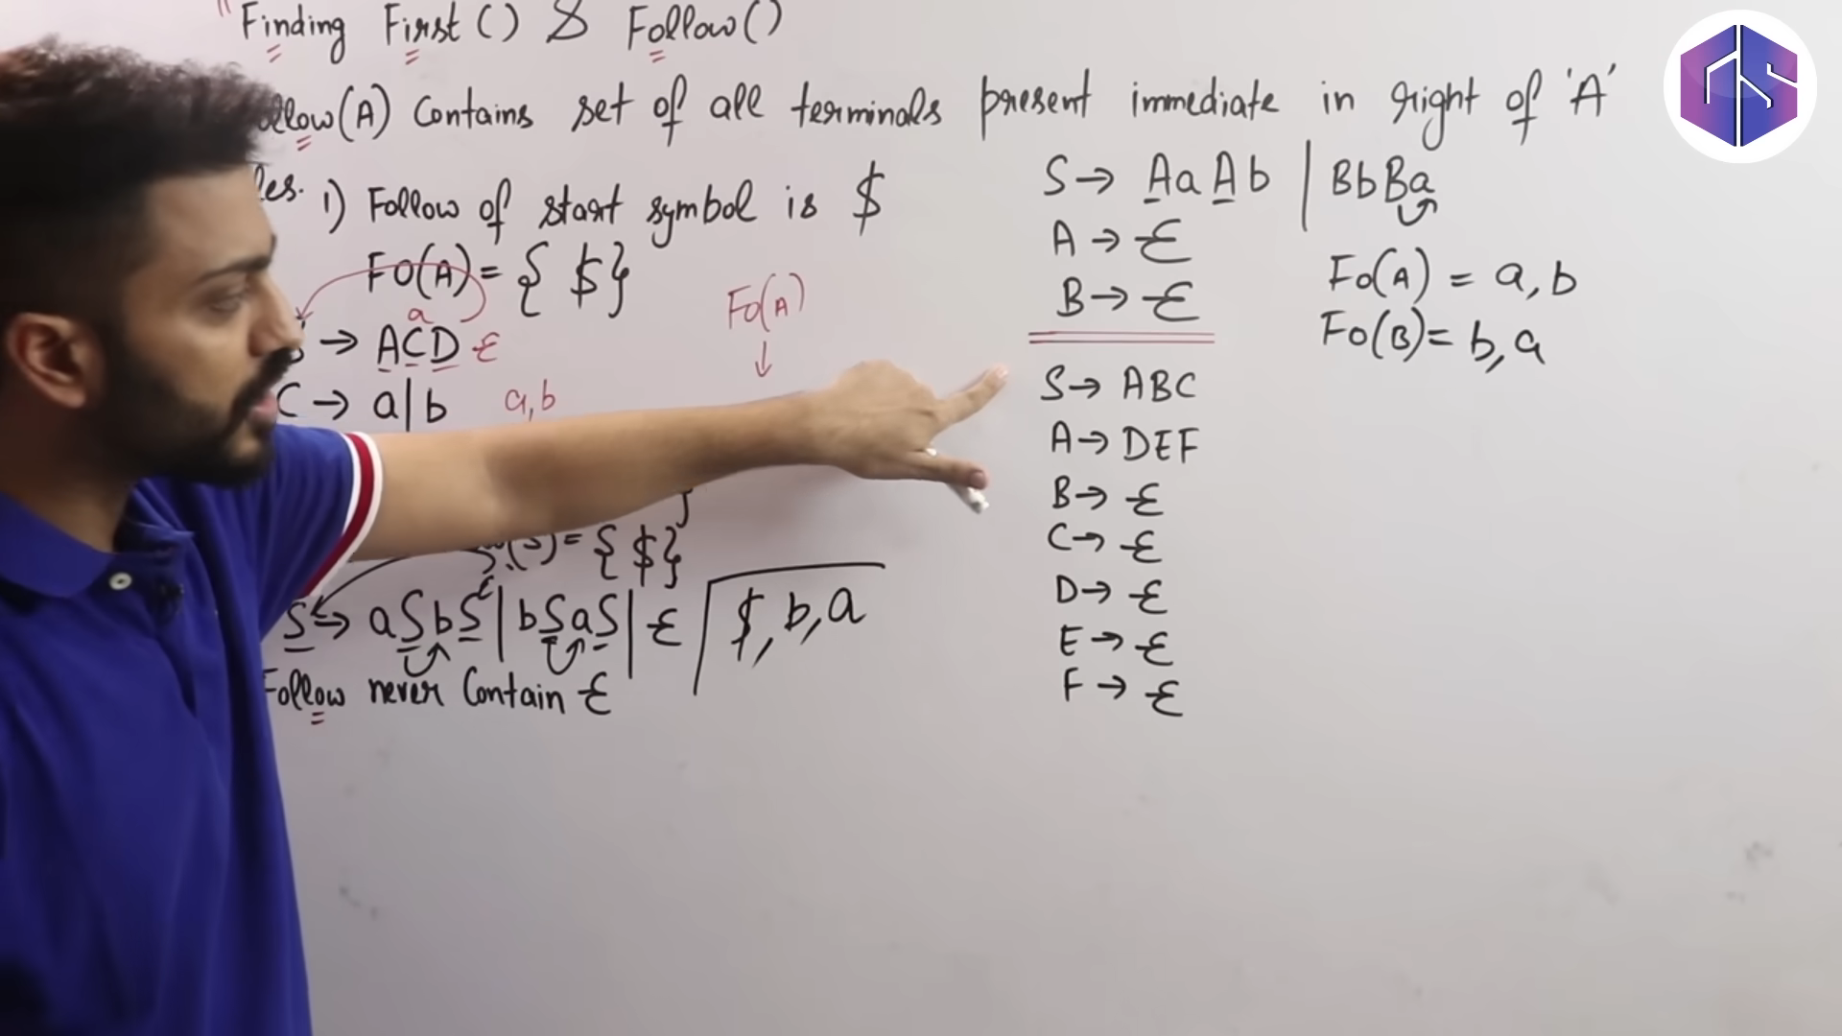

Slide 62
The FOLLOW Function
The FOLLOW Function
Definition (The FOLLOW Function)
For any string of grammar symbols α, FOLLOW(α) is the set of all tokens that may follow α in a derivation.
Top-Down Parsing

Slide 63

Computing FOLLOW(A)
The FOLLOW Function
Computing FOLLOW(A)
Let A be a nonterminal. FOLLOW(A) is computed as follows.
If A is the start symbol, then $ ∈ FOLLOW(A).
If B → αAβ is a production, then
FIRST(β) ⊆ FOLLOW(A).
If B → αA is a production, or B → αAβ is a production and β is nullable, then
FOLLOW(B) ⊆ FOLLOW(A).
Top-Down Parsing

Slide 64
FOLLOW
The FOLLOW Function
We are concerned about FOLLOW(A) only for the nonterminals of the grammar.
According to the definition, to determine FOLLOW(A), we must inspect all productions that have A in their body.
Top-Down Parsing

Slide 65
The FOLLOW Function
Example
FOLLOW(E) = { $, )}
FOLLOW(T) = FIRST(E’) U
FOLLOW(F) = {*, +, $, )}
Example (FOLLOW) Let the grammar be
FOLLOW(E’)= FOLLOW(E)
FOLLOW(T’) = FOLLOW(T)
E → T E′
E′ → + T E′ | ε T → F T ′
T ′ → * F T ′ | ε F → ( E ) | id
FOLLOW(T) = FIRST(E’) U FOLLOW(E)
= {+, $, )}
Top-Down Parsing

Slide 66
Example
The FOLLOW Function
Example (FOLLOW) Find FOLLOW(E).
E is the start symbol, therefore
$ ∈ FOLLOW(E).
E occurs in the body of only one production.
F → ( E )
Therefore
FOLLOW(E) = {$, )}.
Top-Down Parsing

Slide 67
Example
The FOLLOW Function
Example (FOLLOW) Find FOLLOW(E).
E is the start symbol, therefore
$ ∈ FOLLOW(E).
E occurs in the body of only one production.
F → ( E )
Therefore
FOLLOW(E) = {$, )}.
Top-Down Parsing

Slide 68
Example
The FOLLOW Function
Example (FOLLOW) Find FOLLOW(E).
E is the start symbol, therefore
$ ∈ FOLLOW(E).
E occurs in the body of only one production.
F → ( E )
Therefore
FOLLOW(E) = {$, )}.
Top-Down Parsing

Slide 69
Example
The FOLLOW Function
Example (FOLLOW) Find FOLLOW(E′).
E′ occurs in the body of two productions.
E → T E′ E′ → + T E′
Therefore,
FOLLOW(E′) = FOLLOW(E) = {$, )}.
Top-Down Parsing

Slide 70
Example
The FOLLOW Function
Example (FOLLOW) Find FOLLOW(E′).
E′ occurs in the body of two productions.
E → T E′ E′ → + T E′
Therefore,
FOLLOW(E′) = FOLLOW(E) = {$, )}.
Top-Down Parsing

Slide 71
Example
The FOLLOW Function
Example (FOLLOW) Find FOLLOW(T ).
T occurs in the body of two productions.
E → T E′ E′ → + T E′
Therefore, FOLLOW(T ) ⊇ FIRST(E′) = {+}.
However, E′ is nullable, therefore it also contains FOLLOW(E) = {$, )} and FOLLOW(E′) = {$, )}.
Therefore,
FOLLOW(T ) = {+, $, )}.
Top-Down Parsing

Slide 72
Example
The FOLLOW Function
Example (FOLLOW) Find FOLLOW(T ).
T occurs in the body of two productions.
E → T E′ E′ → + T E′
Therefore, FOLLOW(T ) ⊇ FIRST(E′) = {+}.
However, E′ is nullable, therefore it also contains FOLLOW(E) = {$, )} and FOLLOW(E′) = {$, )}.
Therefore,
FOLLOW(T ) = {+, $, )}.
Rokan Uddin Faruqui CSE, CU
Top-Down Parsing
50

Slide 73
Example
The FOLLOW Function
Example (FOLLOW) Find FOLLOW(T ).
T occurs in the body of two productions.
E → T E′ E′ → + T E′
Therefore, FOLLOW(T ) ⊇ FIRST(E′) = {+}.
However, E′ is nullable, therefore it also contains FOLLOW(E) = {$, )} and FOLLOW(E′) = {$, )}.
Therefore,
FOLLOW(T ) = {+, $, )}.
Rokan Uddin Faruqui CSE, CU
Top-Down Parsing
51

Slide 74
Example
The FOLLOW Function
Example (FOLLOW) Find FOLLOW(T ).
T occurs in the body of two productions.
E → T E′ E′ → + T E′
Therefore, FOLLOW(T ) ⊇ FIRST(E′) = {+}.
However, E′ is nullable, therefore it also contains FOLLOW(E) = {$, )} and FOLLOW(E′) = {$, )}.
Therefore,
FOLLOW(T ) = {+, $, )}.
Top-Down Parsing

Slide 75
Example
The FOLLOW Function
Example (FOLLOW) Find FOLLOW(T ′).
T ′ occurs in the body of two productions.
T → F T ′
T ′ → * F T ′
Therefore,
FOLLOW(T′) = FOLLOW(T ) = {+, $, )}.
Top-Down Parsing

Slide 76
Example
The FOLLOW Function
Example (FOLLOW) Find FOLLOW(T ′).
T ′ occurs in the body of two productions.
T → F T ′
T ′ → * F T ′
Therefore,
FOLLOW(T′) = FOLLOW(T ) = {+, $, )}.
Top-Down Parsing

Slide 77
Example
The FOLLOW Function
Example (FOLLOW) Find FOLLOW(F ).
F occurs in the body of two productions.
T → F T ′
T ′ → * F T ′.
Therefore,
FOLLOW(F ) ⊇ FIRST(T′) = {*}.
However, T ′ is nullable, therefore it also contains FOLLOW(T ) = {+, $, )} and FOLLOW(T′) = {+, $, )}.
Therefore,
FOLLOW(F ) = {*, +, $, )}.
Top-Down Parsing

Slide 78
Example
The FOLLOW Function
Example (FOLLOW) Find FOLLOW(F ).
F occurs in the body of two productions.
T → F T ′
T ′ → * F T ′.
Therefore,
FOLLOW(F ) ⊇ FIRST(T′) = {*}.
However, T ′ is nullable, therefore it also contains FOLLOW(T ) = {+, $, )} and FOLLOW(T′) = {+, $, )}.
Therefore,
FOLLOW(F ) = {*, +, $, )}.
Top-Down Parsing

Slide 79
Example
The FOLLOW Function
Example (FOLLOW) Find FOLLOW(F ).
F occurs in the body of two productions.
T → F T ′
T ′ → * F T ′.
Therefore,
FOLLOW(F ) ⊇ FIRST(T′) = {*}.
However, T ′ is nullable, therefore it also contains FOLLOW(T ) = {+, $, )} and FOLLOW(T′) = {+, $, )}.
Therefore,
FOLLOW(F ) = {*, +, $, )}.
Top-Down Parsing

Slide 80
Example
The FOLLOW Function
Example (FOLLOW) Find FOLLOW(F ).
F occurs in the body of two productions.
T → F T ′
T ′ → * F T ′.
Therefore,
FOLLOW(F ) ⊇ FIRST(T′) = {*}.
However, T ′ is nullable, therefore it also contains FOLLOW(T ) = {+, $, )} and FOLLOW(T′) = {+, $, )}.
Therefore,
FOLLOW(F ) = {*, +, $, )}.
Top-Down Parsing

Slide 81
Example
The FOLLOW Function
Example (FOLLOW)
Nonterminal
Nullable
FIRST
FOLLOW
E
No
{(, id}
{$, )}
_{E}′
Yes
{+}
{$, )}
T
No
{(, id}
{$, ), +}
_{T} ′
Yes
{*}
{$, ), +}
F
No
{(, id}
{*, $, ), +}
Top-Down Parsing

Slide 82
Example
The FOLLOW Function
Example (FOLLOW) The grammar
S → ( L ) | id
L → L , S | S
generates nested lists of identifiers. Find FOLLOW(X) for each nonterminal X.
Top-Down Parsing

Slide 83
Example
The FOLLOW Function
Example (FOLLOW) The grammar
R → R ∪ R | R R | R * | ( R ) | id
generates all regular expressions over a set of identifiers. Find FOLLOW(X) for each nonterminal X.
Top-Down Parsing

Slide 84

Outline
The Parse Table Entries
1
Left Factoring
Nullability
2
The FIRST Function
The FOLLOW Function
The Parse Table Entries
6
The Parse Table
Predictive Parsing
7
8 Assignment
Top-Down Parsing

Slide 85
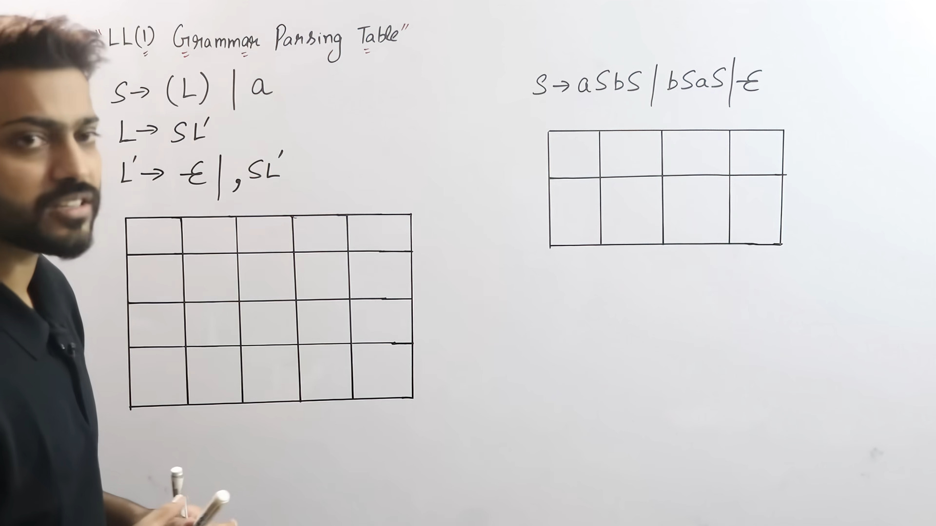

Slide 86
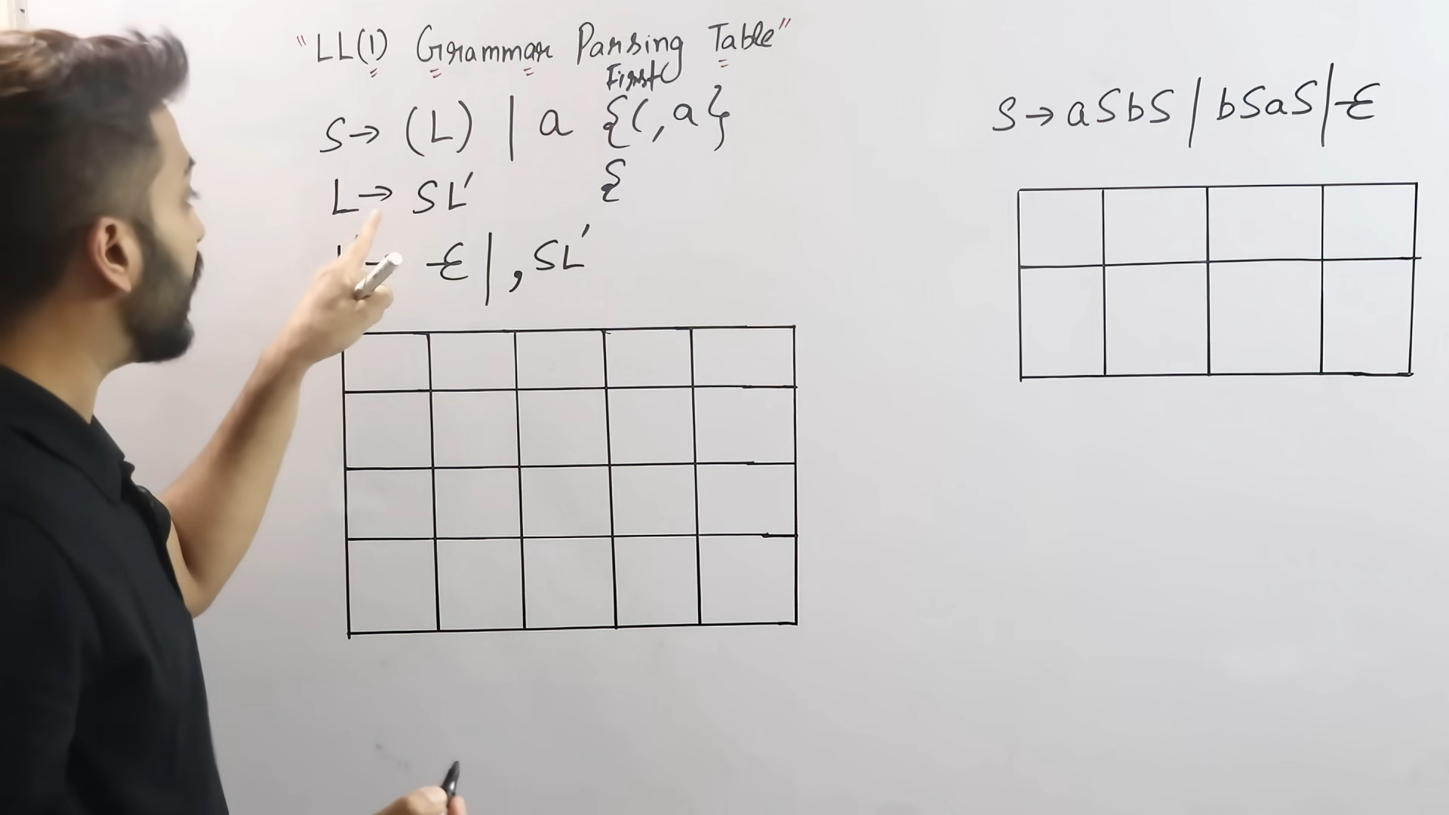

Slide 87
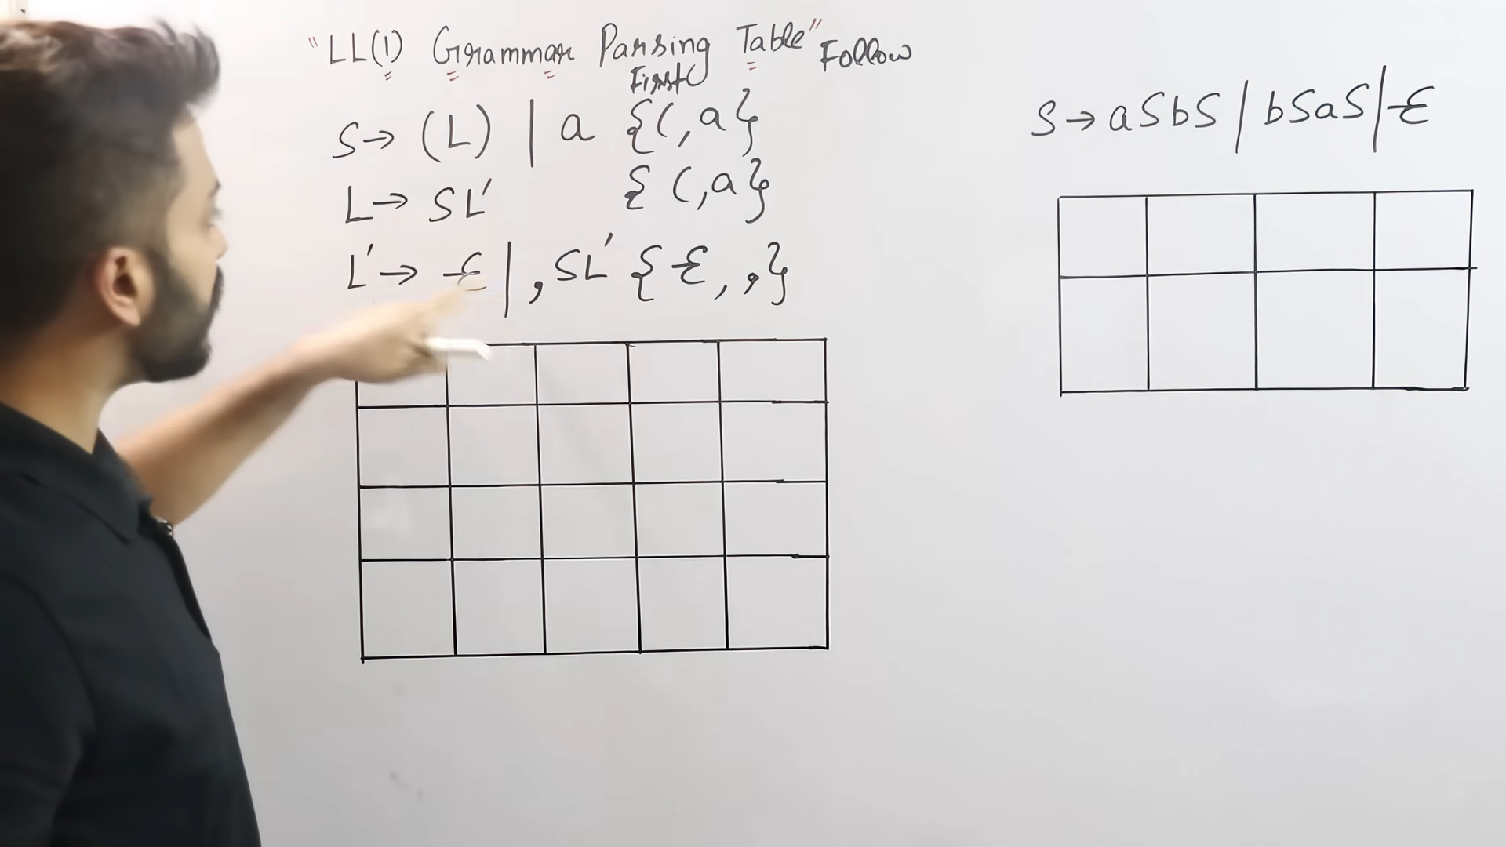

Slide 88
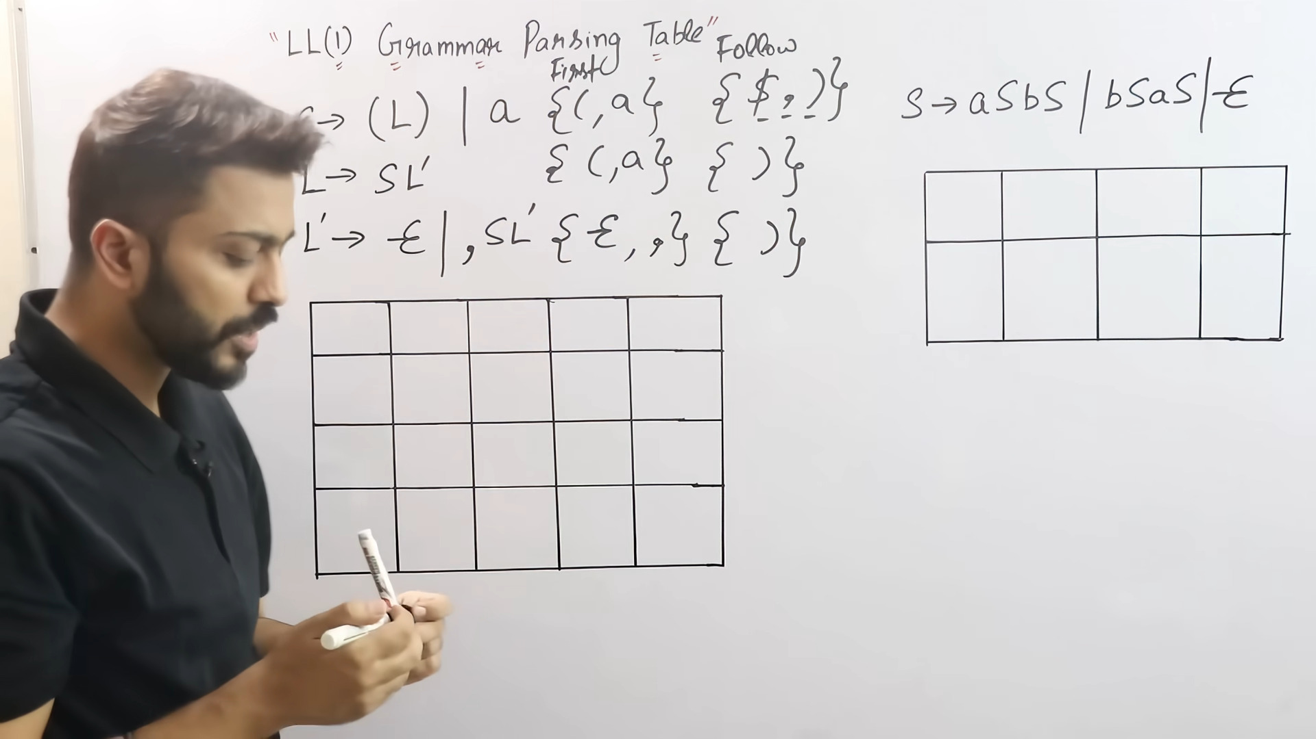

Slide 89
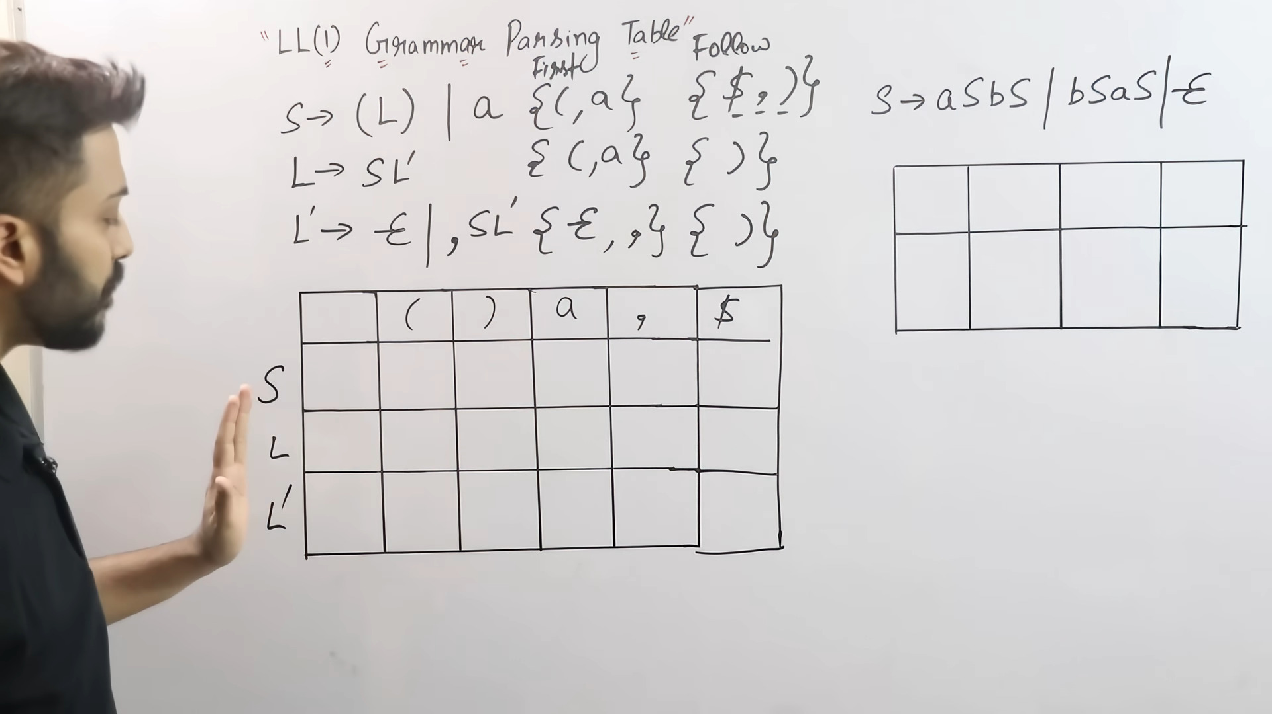

Slide 90
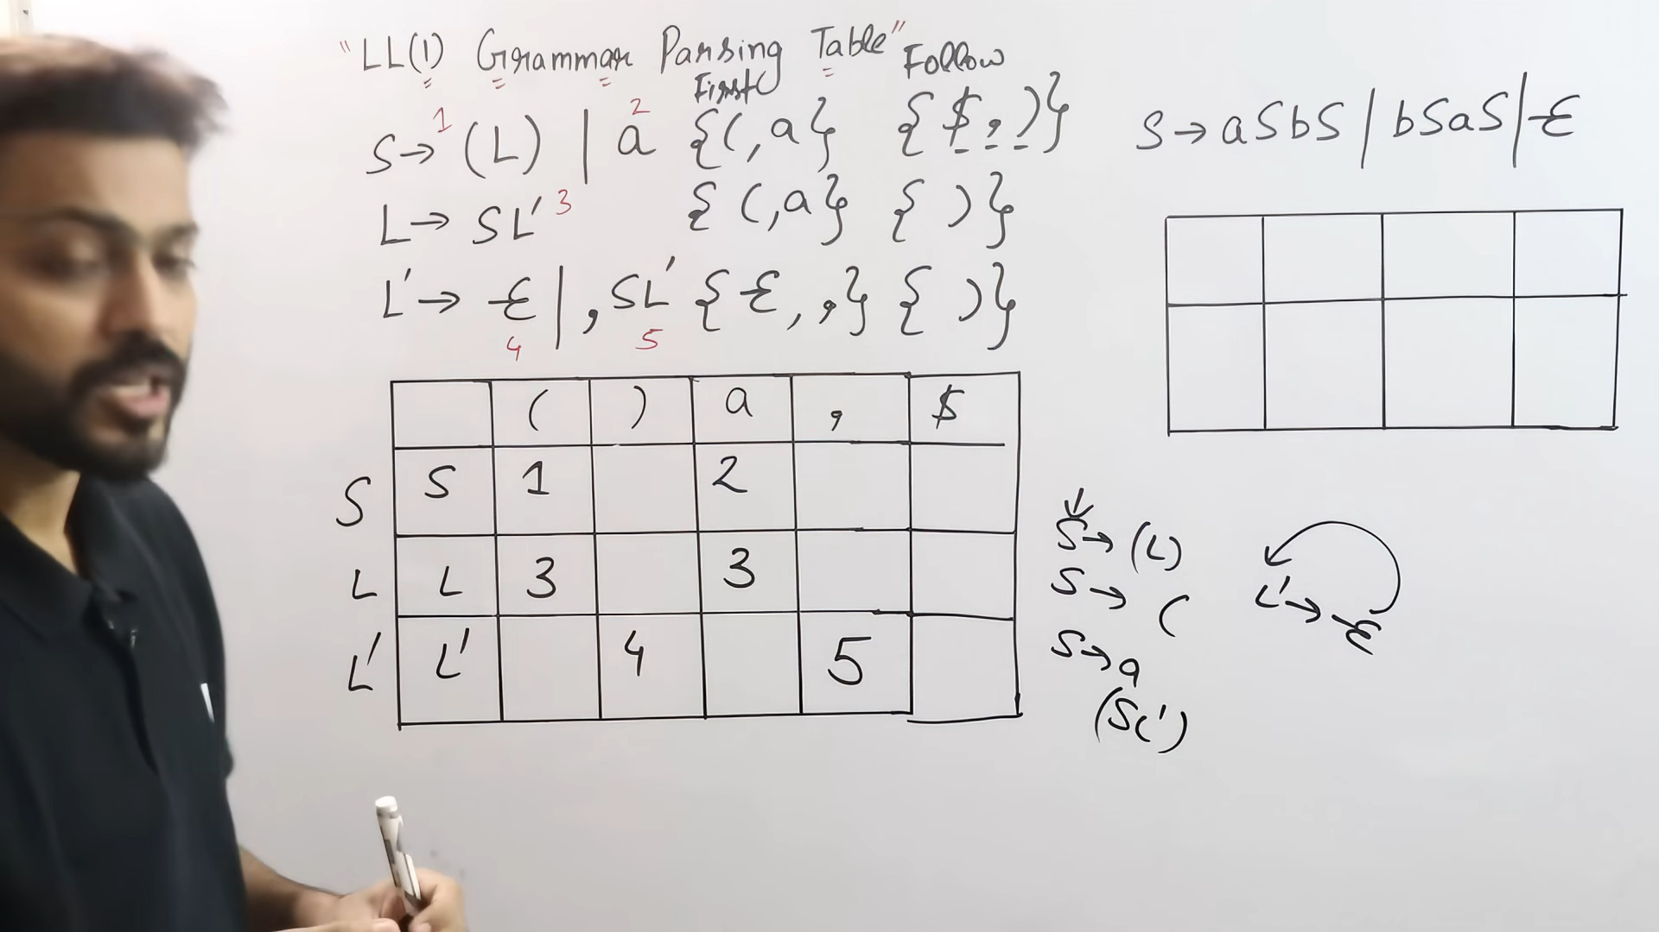
jehetu L’-> epsilon so follow of L’ onujayi oi rule ta bosabo

Slide 91
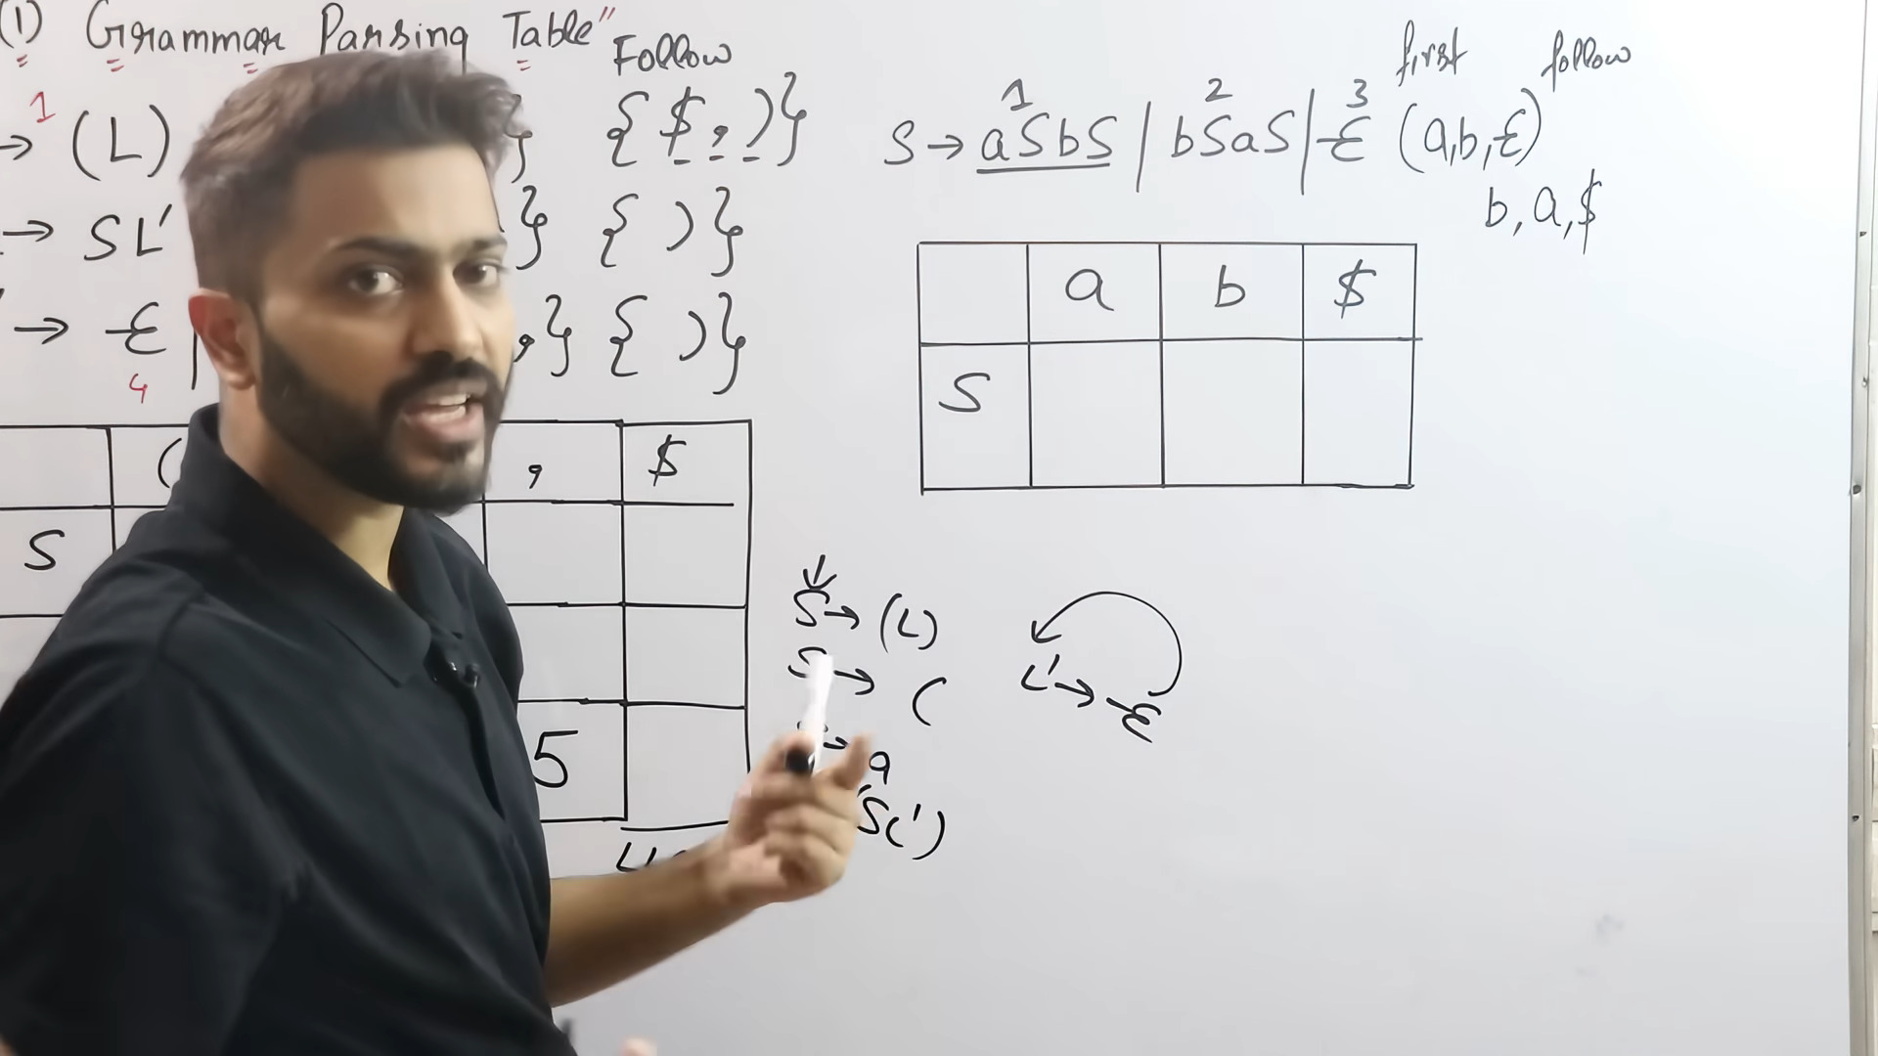

Slide 92
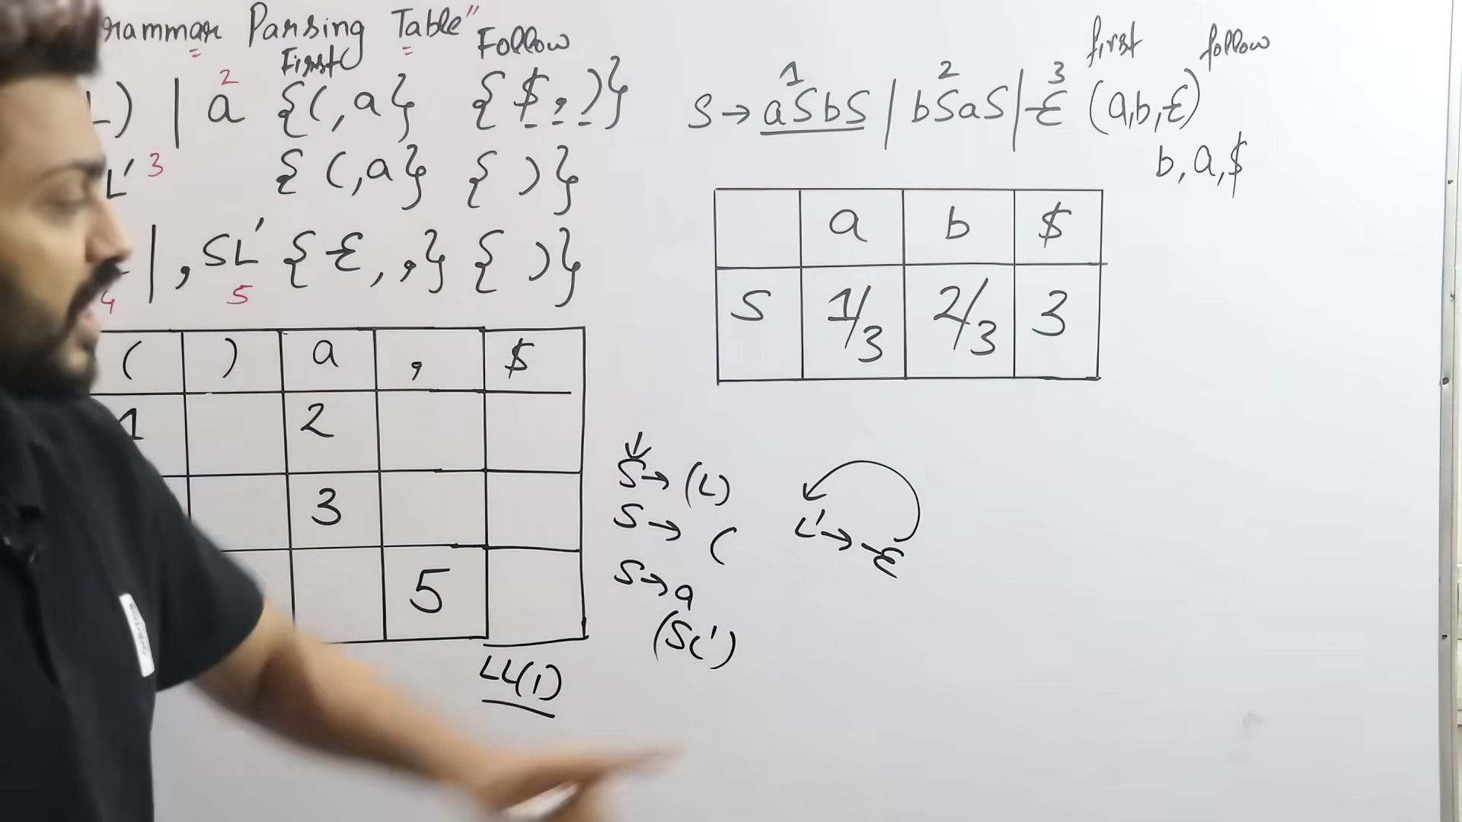

Slide 93
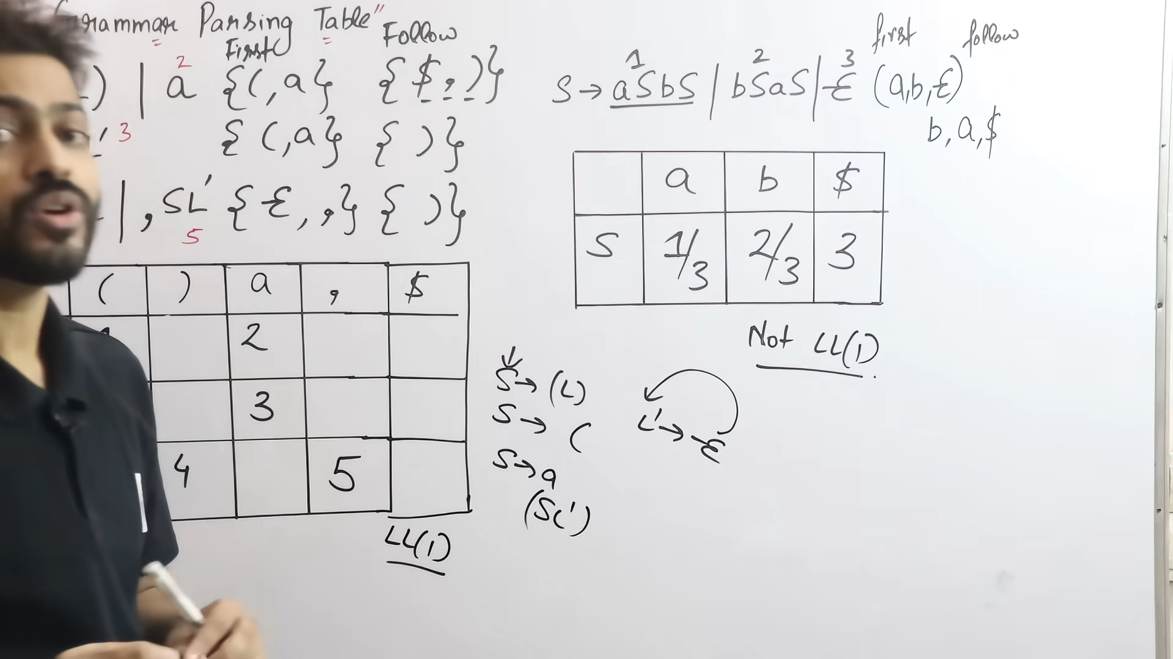

Slide 95
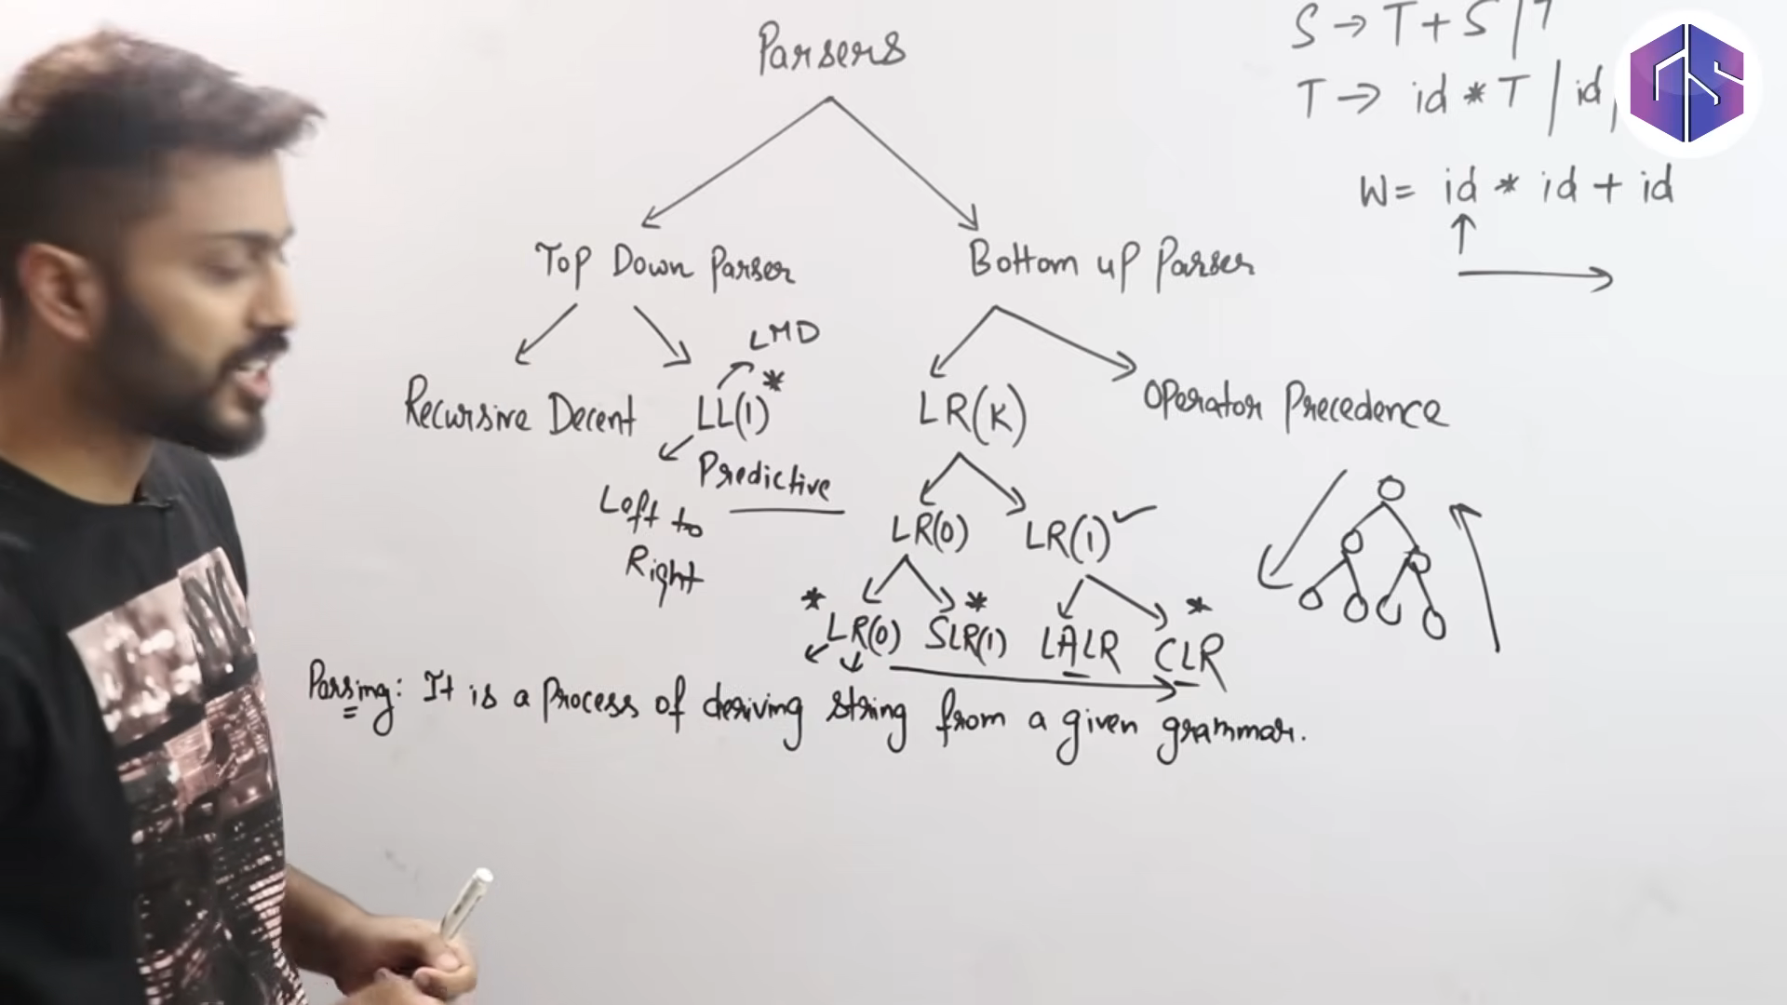

Slide 96
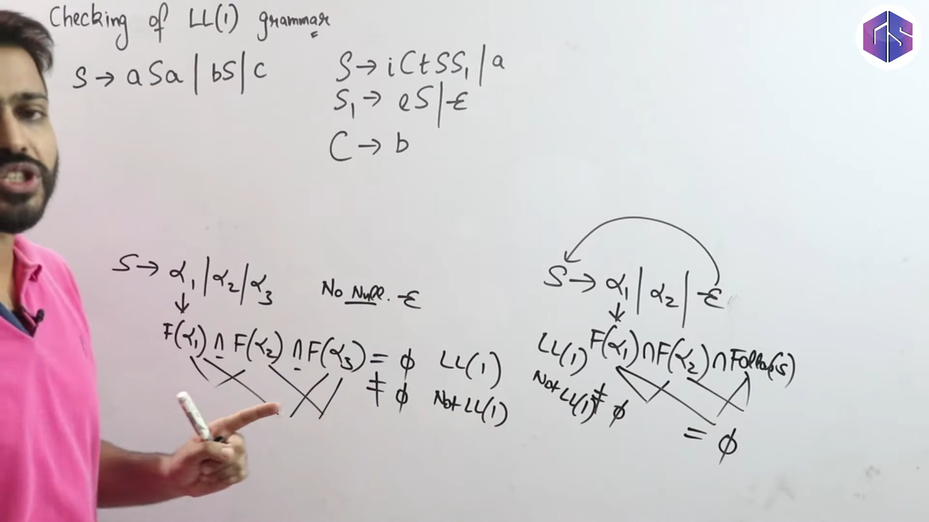

Slide 97
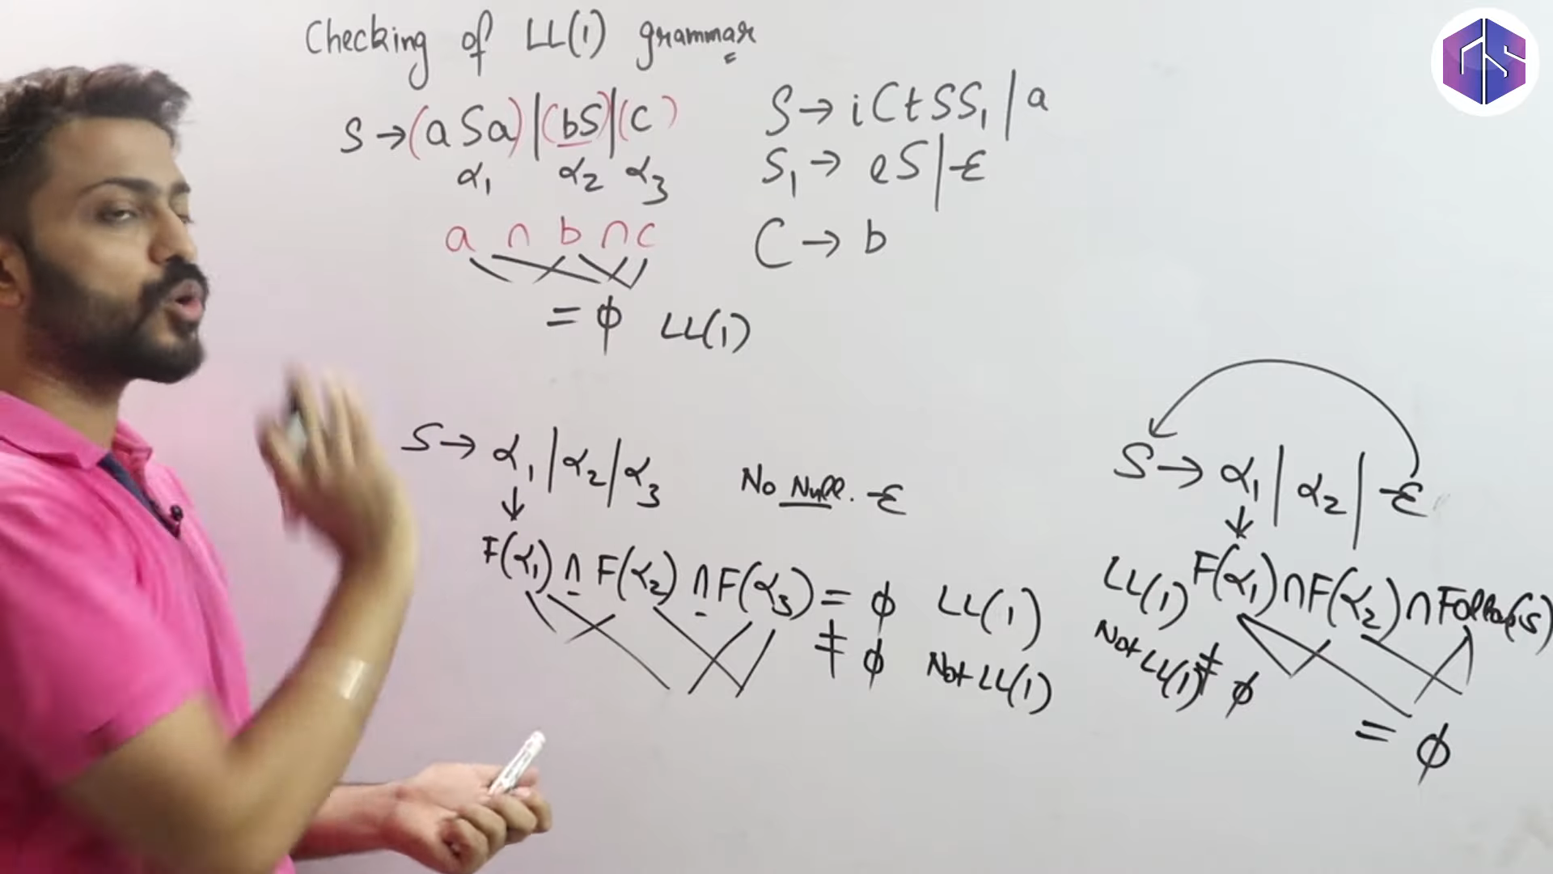

Slide 98
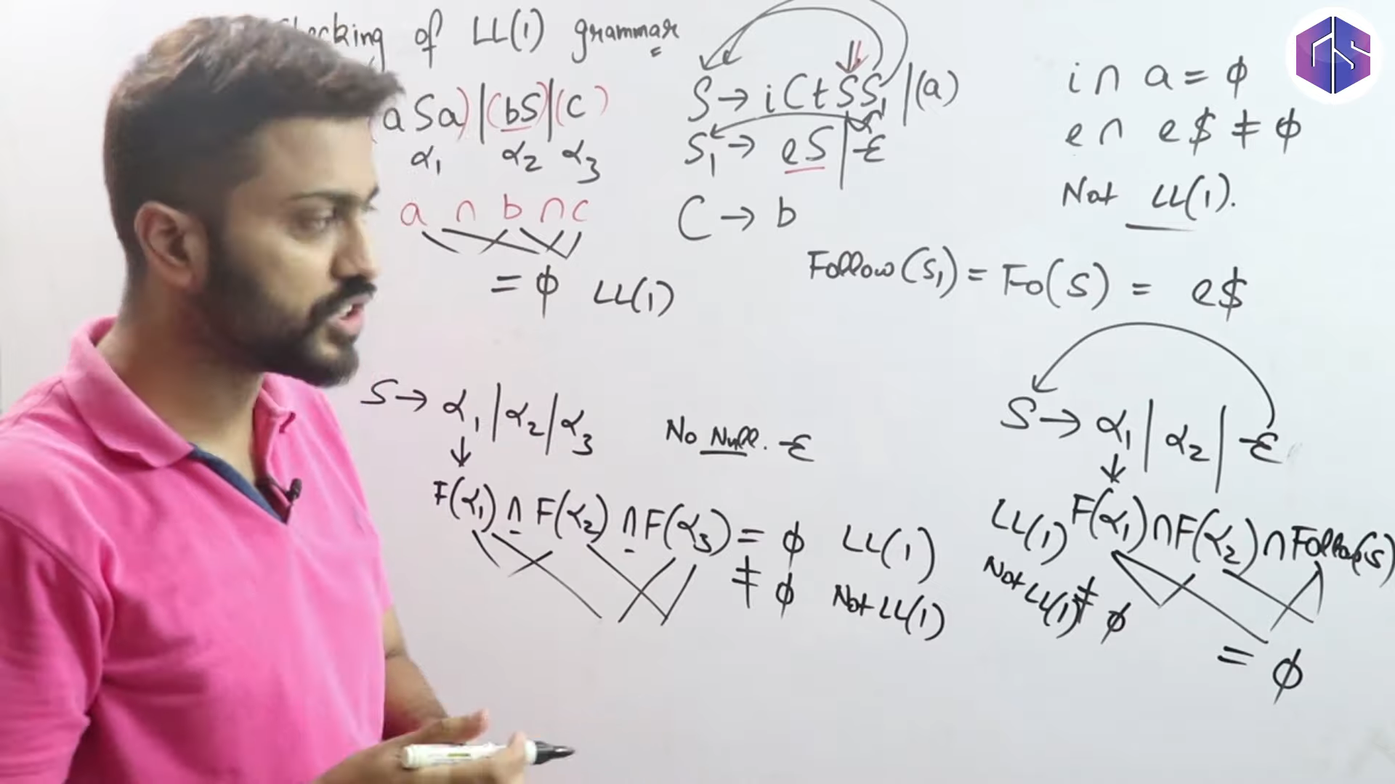

Slide 99
----->> if A -> e then follow(A) nibo
----->>jodi protiti cell a ekti matro entry thake eita k LL(1) parser bolbo

Slide 100
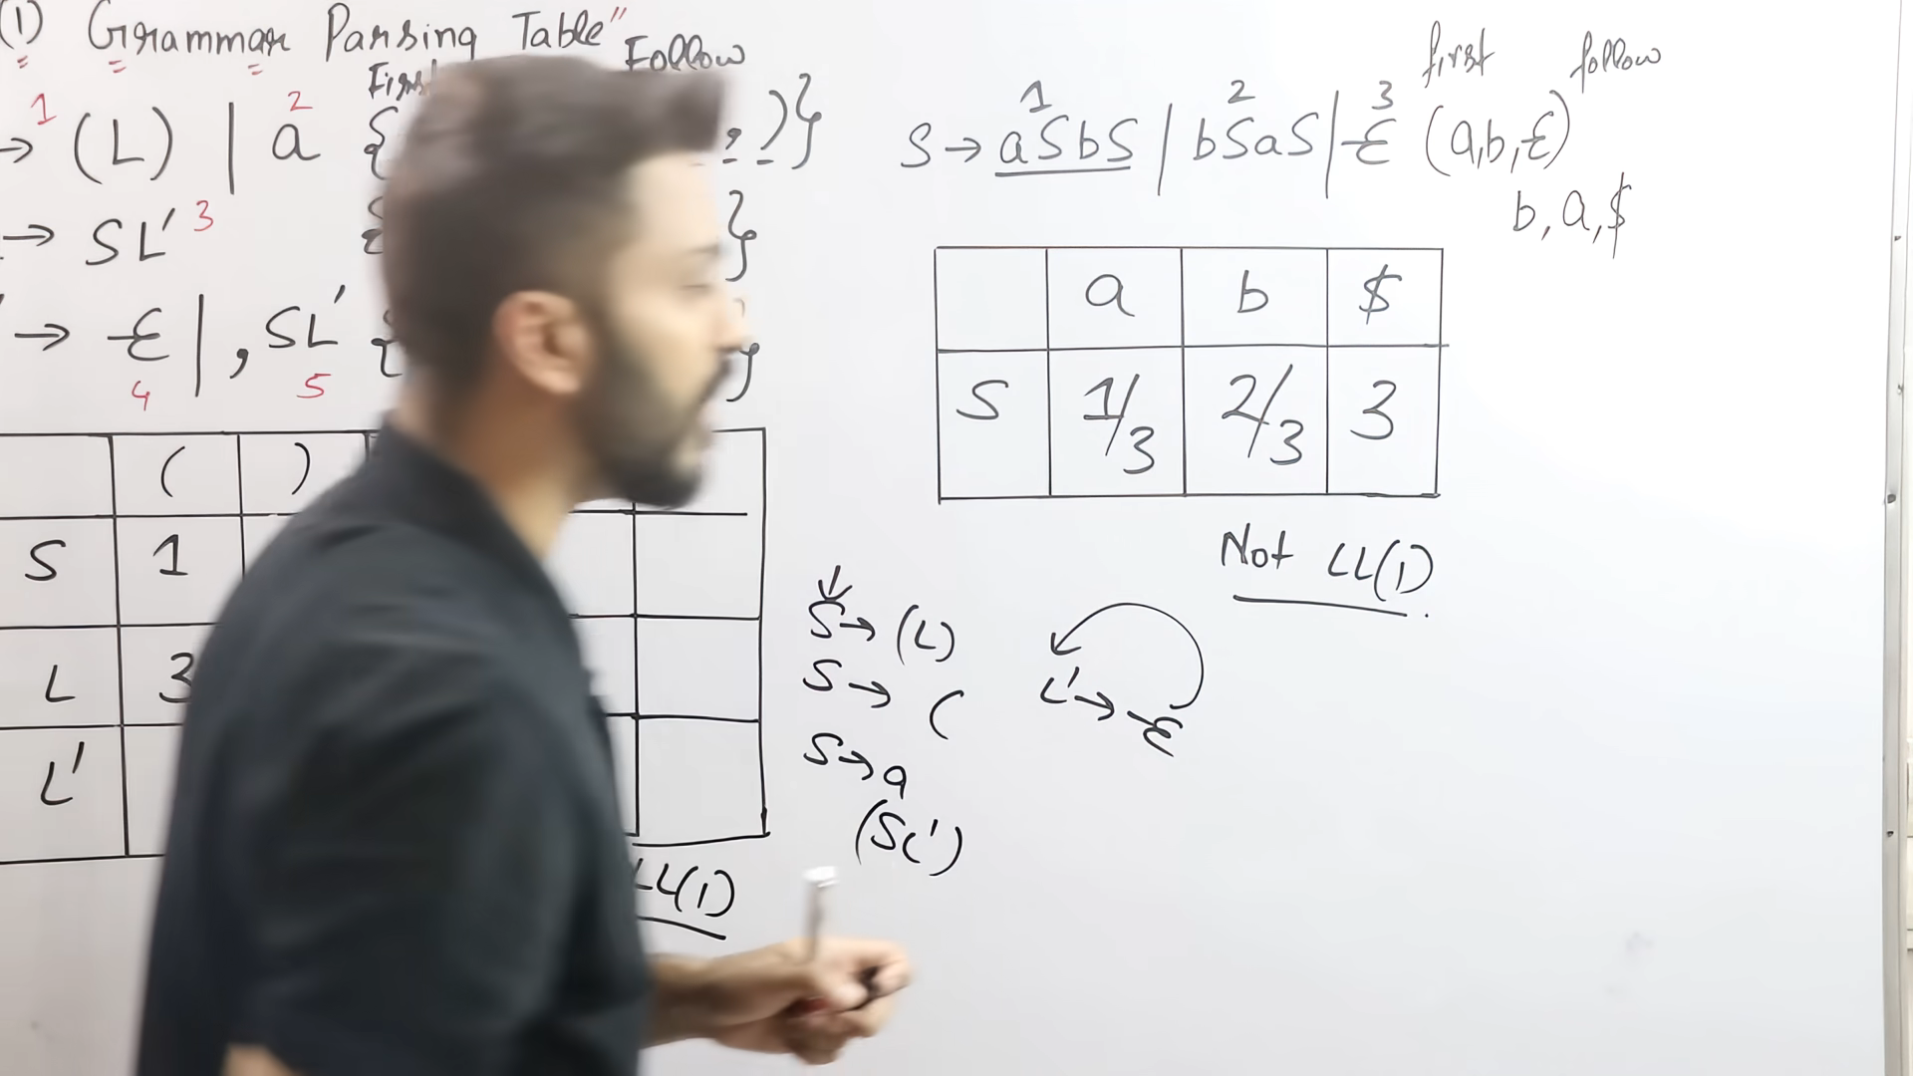

Slide 101
Lec-10: What is LL(1) Parser | How it Works | Full Concept

Slide 102
Nullability and FIRST for Strings
The Parse Table Entries
LL(1) Parsing / Table Driven LL Parsing L = read input left to right
L = leftmost derivation
5 x 6
The parse table has
M[E’,+]
One row for each nonterminal, E, F, T, E’, T’
One column for each terminal and $.
$ is the end-of-file marker.
Each cell in the table represents a combination (A, a) of a
id, +, *, (, ), $
nonterminal A and a terminal a.
id + * ( ) $
E
M[E,id]
M[E’, +]
E’
Top-Down Parsing

Slide 103
Nullability and FIRST for Strings
The Parse Table Entries
E—>TE’|E’ A—> A1A2A3…..A9
FIRST(A)=
We need to extend the definitions of nullable and FIRST to strings
of grammar symbols.
ε is nullable.
Let α = X₁X₂ . . . X_{n} be a string of grammar symbols. Then α is nullable if each X_{i} is nullable.
Top-Down Parsing

Slide 104
Nullability and FIRST for Strings
The Parse Table Entries
By definition, FIRST(ε) = ∅. For the string α = X₁X₂ . . . X_{n},
Let k be the largest integer for which X₁, X₂, …, and X_{k} are nullable.
Then
FIRST(α) = FIRST(X₁) ∪ . . . ∪ FIRST(X_{k+1}).
We will not need FOLLOW for strings.
Top-Down Parsing

Slide 105
The Parse Table Entries
E → T E′ E′ → + T E′ | ε
T → F T ′
T ′ → * F T ′ | ε
F → ( E ) | id
Parse Table Construction : Algorithm
INPUT : Grammar G. OUTPUT : Parsing table M METHOD :
FIRST(TE’)=FIRST(T)={(,id}
M[E,(] = E → T E′
M[E, id] = E → T E′
Each table entry is a production A → α.
Rules for entering A → α in the table:
For every rule A → α and for every a ∈ FIRST(α), write A → α in cell (A, a).
For every rule A → α, where α is nullable, and for every
a ∈ FOLLOW(A), write A → α in cell (A, a).
Write “error” in all cells that do not contain a production.
Top-Down Parsing

Slide 106
Parse Table Entries
The Parse Table Entries
The interpretation of A → α in cell (A, a) is that if A is on top of the stack and we encounter a in the input, then we should replace A by α on the stack.
Push the symbols of α onto the stack in reverse order, from right to left, so that the first (leftmost) symbol is on the top of the stack.
Top-Down Parsing

Slide 107




Example
The Parse Table Entries
Input: G Output: M
1. E -->TE’
A —> alpha, FIRST(alpha) = FIRST(TE’)= FIRST(T) = {(, id} M[E, (] = E—>TE’
Example (Parse Table)
M[E, id] = E—>TE’
3. E’ —> e
Let the grammar be
FOLLOW(E’) = {$, ) }
M[E’, $] = E’ —> e
M[E’, )] = E’ —> e
4. T —>FT’ FIRST(FT’) =FIRST(F) = {(,id}
M[T, (] = T —>FT’
M[T, id] = T—>FT’
2. E’ —> +TE’
FIRST(+TE’) = {+}
M[E’, +] = E’ —> +TE’
E → T E
′
E′ → + T E′ | ε T → F T ′
T ′ → * F T ′ | ε F → ( E ) | id
F—> (E)
F —> id
Top-Down Parsing

Slide 108
The Parse Table Entries
Example
Example (Parse Table) Recall
Nonterminal | Nullable | FIRST | FOLLOW
E | No | {(, id} | {$, )}
_{E}′ | Yes | {+} | {$, )}
T | No | {(, id} | {$, ), +}
_{T} ′ | Yes | {∗} | {$, ), +}
F | No | {(, id} | {∗, $, ), +}
Top-Down Parsing

Slide 109

Outline
The Parse Table
1
Left Factoring
Nullability
2
The FIRST Function
The FOLLOW Function
The Parse Table Entries
6
The Parse Table
Predictive Parsing
7
8 Assignment
Top-Down Parsing

Slide 110
Example
The Parse Table
Example (Parse Table)
Consider the production E → T E′.
FIRST(T E′) = FIRST(T ) = {(, id}.
Therefore, enter E → T E′ in cells (E, () and (E, id). T E′ is not nullable.
Top-Down Parsing

Slide 111
Example
The Parse Table
Example (Parse Table)
Consider the production E′ → ε. FIRST(ε) = ∅.
ε is nullable and FOLLOW(E′) = {$, )}. Therefore, enter E′ → ε in cells (E′, $) and (E′, )).
Top-Down Parsing

Slide 112
Example
The Parse Table
E—> E+ E
Example (Parse Table)
Handle the other productions similarly.
In which cells do we enter E′ → + T E′? In which cells do we enter T → F T ′?
In which cells do we enter T ′ → * F T ′? In which cells do we enter T ′ → ε?
In which cells do we enter F → ( E )? In which cells do we enter F → id?
Top-Down Parsing

Slide 113
Example
The Parse Table
E’ —> +TE’
A —> alpha
E’ —> +TE’ FIRST(+TE’) = {+}
M[E’, +] = E’ —>TE’
FIRST(alpha)
T’ —> *FT’
T —> FT
FISRT(*FT’) = {*}
FIRST(FT) = FIRST(F) = { id, ( } M[T, id] = T—>FT’
M[T, (] = T —> FT’
M[E, (] = E → T E′
Example (Parse Table)
M[E, id] = E → T E′
 | + | * | ( | ) | id | $
E |  |  | E → T E′ |  | E → T E′
_{E}′ | E′ → + T E′ |  |  | E′ → ε |  | E′ → ε
T |  |  | T → F T ′ |  | T → F T ′
_{T} ′ | T ′ → ε | T ′ → * F T ′ |  | T ′ → ε |  | T ′ → ε
F |  |  | F → ( E ) |  | F → id
E′ → ε
FOLLOW(E’) = { $, )}
T’ —>e
M[E’, $] = E′ → ε
M[E’, )] = E′ → ε
FOLLOW(T’) = { +, ),
Is it LL(1)?
Top-Down Parsing

Slide 114
Outline
Predictive Parsing
1
Left Factoring
Nullability
2
The FIRST Function
The FOLLOW Function
The Parse Table Entries
6
The Parse Table
Predictive Parsing
7
8 Assignment
Top-Down Parsing

Slide 115
Predictive Parsing
Predictive Parsing
Definition (LL(1) Grammar)
An LL(1) grammar is a grammar whose predictive parse table does not contain any multiple entries.
A multiple entry would indicate that we could not decide which production to apply.
Top-Down Parsing

Slide 116












Predictive Parsing
Predictive Parsing
E —> E + T | T T —> T * F | F
F —> (E) | id
PDA
Figure: Model of a table-driven predictive parsing
Top-Down Parsing

Slide 117
Predictive Parsing Algorithm
Predictive Parsing
The predictive parsing algorithm uses
The parse table,
An input buffer containing a sequence of tokens, A stack of grammar symbols.
Top-Down Parsing

Slide 118

Predictive Parsing Algorithm
Predictive Parsing
The Parsing Algorithm
Initialize the input buffer to the input followed by $.
Initialize the stack to $ and S, with S on the top.
E$
id+id*id$
Top-Down Parsing

Slide 119
Predictive Parsing Algorithm
Predictive Parsing
id * (id + id)
id
E --> TE’
The Parsing Algorithm
Stack: E input: id
Consider the top stack symbol X. There are three possibilities.
X is a terminal.
X is a nonterminal.
X is $.
M[E,id] = E--> TE’
Top-Down Parsing

Slide 120


Predictive Parsing Algorithm
Predictive Parsing
id + id $
T E’
The Parsing Algorithm
If X is a terminal, then
If X matches the current token,
Pop X from the stack. Advance to the next token.
Otherwise, it is an error.
Top-Down Parsing

Slide 121

Predictive Parsing Algorithm
Predictive Parsing
The Parsing Algorithm
If X is a nonterminal, then
Use X together with the current token to get the entry from the parse table.
If the entry is a production,
Pop X from the stack.
Push the symbols on the right-hand side of the production, from right to left, onto the stack.
Otherwise, it is an error.
Top-Down Parsing

Slide 122

Predictive Parsing Algorithm
Predictive Parsing
The Parsing Algorithm If X is $, then
If the current token is also $,
Accept the input.
Otherwise, it is an error.
Top-Down Parsing

Slide 123
Stack
Predictive Parsing
Input
( id + id ) * id $ ( id + id ) * id $ ( id + id ) * id $ id + id ) * id $
Example
E$ TE’$ FT’E’$
(id)T’E’$
id)T’E’$
M[E,(]
Example (Predictive Parsing) Parse the string (id + id)*id.
Stack
Input
(
$E
$E’T
$E’T’F
$E’T’)E(
$E’T’)E
(id + id) * id$ (id+id) * id$ (id+id) * id$ (id+id) * id$ id+id)*id$
E
)
T’
E’
$
X = (
Input = ( M[T, (] = E —> TE’
Top-Down Parsing

Slide 124
ExampleM[E,(] = E—>TE’
Predictive Parsing
(id + id) * id$
$E
input: ( stack: E
$E’T
Example (Predictive Parsing)
Stack | Input
$ E | ( id + id ) * id $
$ E′ T | ( id + id ) * id $
$ E′ T ′ F | ( id + id ) * id $
$ E′ T ′ ) E ( | ( id + id ) * id $
$ E′ T ′ ) E | id + id ) * id $
$ E′ T ′ ) E′ T | id + id ) * id $
$ E′ T ′ ) E′ T ′ F | id + id ) * id $
$ E′ T ′ ) E′ T ′ id | id + id ) * id $
$ E′ T ′ ) E′ T ′ | + id ) * id $
$ E′ T ′ ) E′ | + id ) * id $
$ E′ T ′ ) E′ T + | + id ) * id $
$ E′ T ′ ) E′ T | id ) * id $
E, (] = E —> TE’
Top-Down Parsing

Slide 125
Predictive Parsing
Example
Example (Predictive Parsing)
Stack | Input
$ E | ( id + id ) * id $
$ E′ T | ( id + id ) * id $
$ E′ T ′ F | ( id + id ) * id $
$ E′ T ′ ) E ( | ( id + id ) * id $
$ E′ T ′ ) E | id + id ) * id $
$ E′ T ′ ) E′ T | id + id ) * id $
$ E′ T ′ ) E′ T ′ F | id + id ) * id $
$ E′ T ′ ) E′ T ′ id | id + id ) * id $
$ E′ T ′ ) E′ T ′ | + id ) * id $
$ E′ T ′ ) E′ | + id ) * id $
$ E′ T ′ ) E′ T + | + id ) * id $
$ E′ T ′ ) E′ T | id ) * id $
Top-Down Parsing

Slide 126
Predictive Parsing
Example
M[F,(] = F —> (E)
Example (Predictive Parsing)
Stack | Input
$ E | ( id + id ) * id $
$ E′ T | ( id + id ) * id $
$ E′ T ′ F | ( id + id ) * id $
$ E′ T ′ ) E ( | ( id + id ) * id $
$ E′ T ′ ) E | id + id ) * id $
$ E′ T ′ ) E′ T | id + id ) * id $
$ E′ T ′ ) E′ T ′ F | id + id ) * id $
$ E′ T ′ ) E′ T ′ id | id + id ) * id $
$ E′ T ′ ) E′ T ′ | + id ) * id $
$ E′ T ′ ) E′ | + id ) * id $
$ E′ T ′ ) E′ T + | + id ) * id $
$ E′ T ′ ) E′ T | id ) * id $
Top-Down Parsing

Slide 127
Predictive Parsing
Example
F -> (E)
Example (Predictive Parsing)
Stack | Input
$ E | ( id + id ) * id $
$ E′ T | ( id + id ) * id $
$ E′ T ′ F | ( id + id ) * id $
$ E′ T ′ ) E ( | ( id + id ) * id $
$ E′ T ′ ) E | id + id ) * id $
$ E′ T ′ ) E′ T | id + id ) * id $
$ E′ T ′ ) E′ T ′ F | id + id ) * id $
$ E′ T ′ ) E′ T ′ id | id + id ) * id $
$ E′ T ′ ) E′ T ′ | + id ) * id $
$ E′ T ′ ) E′ | + id ) * id $
$ E′ T ′ ) E′ T + | + id ) * id $
$ E′ T ′ ) E′ T | id ) * id $
Top-Down Parsing

Slide 128

Predictive Parsing
Example
Example (Predictive Parsing)
Stack | Input
$ E | ( id + id ) * id $
$ E′ T | ( id + id ) * id $
$ E′ T ′ F | ( id + id ) * id $
$ E′ T ′ ) E ( | ( id + id ) * id $
$ E′ T ′ ) E | id + id ) * id $
$ E′ T ′ ) E′ T | id + id ) * id $
$ E′ T ′ ) E′ T ′ F | id + id ) * id $
$ E′ T ′ ) E′ T ′ id | id + id ) * id $
$ E′ T ′ ) E′ T ′ | + id ) * id $
$ E′ T ′ ) E′ | + id ) * id $
$ E′ T ′ ) E′ T + | + id ) * id $
$ E′ T ′ ) E′ T | id ) * id $
Top-Down Parsing

Slide 129
Predictive Parsing
Example
Example (Predictive Parsing)
Stack | Input
$ E | ( id + id ) * id $
$ E′ T | ( id + id ) * id $
$ E′ T ′ F | ( id + id ) * id $
$ E′ T ′ ) E ( | ( id + id ) * id $
$ E′ T ′ ) E | id + id ) * id $
$ E′ T ′ ) E′ T | id + id ) * id $
$ E′ T ′ ) E′ T ′ F | id + id ) * id $
$ E′ T ′ ) E′ T ′ id | id + id ) * id $
$ E′ T ′ ) E′ T ′ | + id ) * id $
$ E′ T ′ ) E′ | + id ) * id $
$ E′ T ′ ) E′ T + | + id ) * id $
$ E′ T ′ ) E′ T | id ) * id $
Top-Down Parsing

Slide 130
Predictive Parsing
Example
Example (Predictive Parsing)
Stack | Input
$ E | ( id + id ) * id $
$ E′ T | ( id + id ) * id $
$ E′ T ′ F | ( id + id ) * id $
$ E′ T ′ ) E ( | ( id + id ) * id $
$ E′ T ′ ) E | id + id ) * id $
$ E′ T ′ ) E′ T | id + id ) * id $
$ E′ T ′ ) E′ T ′ F | id + id ) * id $
$ E′ T ′ ) E′ T ′ id | id + id ) * id $
$ E′ T ′ ) E′ T ′ | + id ) * id $
$ E′ T ′ ) E′ | + id ) * id $
$ E′ T ′ ) E′ T + | + id ) * id $
$ E′ T ′ ) E′ T | id ) * id $
Top-Down Parsing

Slide 131
Predictive Parsing
Example
Example (Predictive Parsing)
Stack | Input
$ E | ( id + id ) * id $
$ E′ T | ( id + id ) * id $
$ E′ T ′ F | ( id + id ) * id $
$ E′ T ′ ) E ( | ( id + id ) * id $
$ E′ T ′ ) E | id + id ) * id $
$ E′ T ′ ) E′ T | id + id ) * id $
$ E′ T ′ ) E′ T ′ F | id + id ) * id $
$ E′ T ′ ) E′ T ′ id | id + id ) * id $
$ E′ T ′ ) E′ T ′ | + id ) * id $
$ E′ T ′ ) E′ | + id ) * id $
$ E′ T ′ ) E′ T + | + id ) * id $
$ E′ T ′ ) E′ T | id ) * id $
Top-Down Parsing

Slide 132
Predictive Parsing
Example
Example (Predictive Parsing)
Stack | Input
$ E | ( id + id ) * id $
$ E′ T | ( id + id ) * id $
$ E′ T ′ F | ( id + id ) * id $
$ E′ T ′ ) E ( | ( id + id ) * id $
$ E′ T ′ ) E | id + id ) * id $
$ E′ T ′ ) E′ T | id + id ) * id $
$ E′ T ′ ) E′ T ′ F | id + id ) * id $
$ E′ T ′ ) E′ T ′ id | id + id ) * id $
$ E′ T ′ ) E′ T ′ | + id ) * id $
$ E′ T ′ ) E′ | + id ) * id $
$ E′ T ′ ) E′ T + | + id ) * id $
$ E′ T ′ ) E′ T | id ) * id $
Top-Down Parsing

Slide 133
Predictive Parsing
Example
Example (Predictive Parsing)
Stack | Input
$ E | ( id + id ) * id $
$ E′ T | ( id + id ) * id $
$ E′ T ′ F | ( id + id ) * id $
$ E′ T ′ ) E ( | ( id + id ) * id $
$ E′ T ′ ) E | id + id ) * id $
$ E′ T ′ ) E′ T | id + id ) * id $
$ E′ T ′ ) E′ T ′ F | id + id ) * id $
$ E′ T ′ ) E′ T ′ id | id + id ) * id $
$ E′ T ′ ) E′ T ′ | + id ) * id $
$ E′ T ′ ) E′ | + id ) * id $
$ E′ T ′ ) E′ T + | + id ) * id $
$ E′ T ′ ) E′ T | id ) * id $
Top-Down Parsing

Slide 134
Predictive Parsing
Example
Example (Predictive Parsing)
Stack | Input
$ E | ( id + id ) * id $
$ E′ T | ( id + id ) * id $
$ E′ T ′ F | ( id + id ) * id $
$ E′ T ′ ) E ( | ( id + id ) * id $
$ E′ T ′ ) E | id + id ) * id $
$ E′ T ′ ) E′ T | id + id ) * id $
$ E′ T ′ ) E′ T ′ F | id + id ) * id $
$ E′ T ′ ) E′ T ′ id | id + id ) * id $
$ E′ T ′ ) E′ T ′ | + id ) * id $
$ E′ T ′ ) E′ | + id ) * id $
$ E′ T ′ ) E′ T + | + id ) * id $
$ E′ T ′ ) E′ T | id ) * id $
Top-Down Parsing

Slide 135
Predictive Parsing
Example
Example (Predictive Parsing)
Stack | Input
$ E | ( id + id ) * id $
$ E′ T | ( id + id ) * id $
$ E′ T ′ F | ( id + id ) * id $
$ E′ T ′ ) E ( | ( id + id ) * id $
$ E′ T ′ ) E | id + id ) * id $
$ E′ T ′ ) E′ T | id + id ) * id $
$ E′ T ′ ) E′ T ′ F | id + id ) * id $
$ E′ T ′ ) E′ T ′ id | id + id ) * id $
$ E′ T ′ ) E′ T ′ | + id ) * id $
$ E′ T ′ ) E′ | + id ) * id $
$ E′ T ′ ) E′ T + | + id ) * id $
$ E′ T ′ ) E′ T | id ) * id $
Top-Down Parsing

Slide 136
Predictive Parsing
Example
Example (Predictive Parsing)
Stack | Input
$ E′ T ′ ) E′ T ′ F | id ) * id $
$ E′ T ′ ) E′ T ′ id | id ) * id $
$ E′ T ′ ) E′ T ′ | ) * id $
$ E′ T ′ ) E′ | ) * id $
$ E′ T ′ ) | ) * id $
$ E′ T ′ | * id $
$ E′ T ′ F * | * id $
$ E′ T ′ F | id $
$ E′ T ′ id | id $
$ E′ T ′ | $
$ E′ | $
$ | $
Top-Down Parsing

Slide 137
Predictive Parsing
Example
Example (Predictive Parsing)
Stack | Input
$ E′ T ′ ) E′ T ′ F | id ) * id $
$ E′ T ′ ) E′ T ′ id | id ) * id $
$ E′ T ′ ) E′ T ′ | ) * id $
$ E′ T ′ ) E′ | ) * id $
$ E′ T ′ ) | ) * id $
$ E′ T ′ | * id $
$ E′ T ′ F * | * id $
$ E′ T ′ F | id $
$ E′ T ′ id | id $
$ E′ T ′ | $
$ E′ | $
$ | $
Top-Down Parsing

Slide 138
Predictive Parsing
Example
Example (Predictive Parsing)
Stack | Input
$ E′ T ′ ) E′ T ′ F | id ) * id $
$ E′ T ′ ) E′ T ′ id | id ) * id $
$ E′ T ′ ) E′ T ′ | ) * id $
$ E′ T ′ ) E′ | ) * id $
$ E′ T ′ ) | ) * id $
$ E′ T ′ | * id $
$ E′ T ′ F * | * id $
$ E′ T ′ F | id $
$ E′ T ′ id | id $
$ E′ T ′ | $
$ E′ | $
$ | $
Top-Down Parsing

Slide 139
Predictive Parsing
Example
Example (Predictive Parsing)
Stack | Input
$ E′ T ′ ) E′ T ′ F | id ) * id $
$ E′ T ′ ) E′ T ′ id | id ) * id $
$ E′ T ′ ) E′ T ′ | ) * id $
$ E′ T ′ ) E′ | ) * id $
$ E′ T ′ ) | ) * id $
$ E′ T ′ | * id $
$ E′ T ′ F * | * id $
$ E′ T ′ F | id $
$ E′ T ′ id | id $
$ E′ T ′ | $
$ E′ | $
$ | $
Top-Down Parsing

Slide 140
Predictive Parsing
Example
Example (Predictive Parsing)
Stack | Input
$ E′ T ′ ) E′ T ′ F | id ) * id $
$ E′ T ′ ) E′ T ′ id | id ) * id $
$ E′ T ′ ) E′ T ′ | ) * id $
$ E′ T ′ ) E′ | ) * id $
$ E′ T ′ ) | ) * id $
$ E′ T ′ | * id $
$ E′ T ′ F * | * id $
$ E′ T ′ F | id $
$ E′ T ′ id | id $
$ E′ T ′ | $
$ E′ | $
$ | $
Top-Down Parsing

Slide 141
Predictive Parsing
Example
Example (Predictive Parsing)
Stack | Input
$ E′ T ′ ) E′ T ′ F | id ) * id $
$ E′ T ′ ) E′ T ′ id | id ) * id $
$ E′ T ′ ) E′ T ′ | ) * id $
$ E′ T ′ ) E′ | ) * id $
$ E′ T ′ ) | ) * id $
$ E′ T ′ | * id $
$ E′ T ′ F * | * id $
$ E′ T ′ F | id $
$ E′ T ′ id | id $
$ E′ T ′ | $
$ E′ | $
$ | $
Top-Down Parsing

Slide 142
Predictive Parsing
Example
Example (Predictive Parsing)
Stack | Input
$ E′ T ′ ) E′ T ′ F | id ) * id $
$ E′ T ′ ) E′ T ′ id | id ) * id $
$ E′ T ′ ) E′ T ′ | ) * id $
$ E′ T ′ ) E′ | ) * id $
$ E′ T ′ ) | ) * id $
$ E′ T ′ | * id $
$ E′ T ′ F * | * id $
$ E′ T ′ F | id $
$ E′ T ′ id | id $
$ E′ T ′ | $
$ E′ | $
$ | $
Top-Down Parsing

Slide 143
Predictive Parsing
Example
Example (Predictive Parsing)
Stack | Input
$ E′ T ′ ) E′ T ′ F | id ) * id $
$ E′ T ′ ) E′ T ′ id | id ) * id $
$ E′ T ′ ) E′ T ′ | ) * id $
$ E′ T ′ ) E′ | ) * id $
$ E′ T ′ ) | ) * id $
$ E′ T ′ | * id $
$ E′ T ′ F * | * id $
$ E′ T ′ F | id $
$ E′ T ′ id | id $
$ E′ T ′ | $
$ E′ | $
$ | $
Top-Down Parsing

Slide 144
Predictive Parsing
Example
Example (Predictive Parsing)
Stack | Input
$ E′ T ′ ) E′ T ′ F | id ) * id $
$ E′ T ′ ) E′ T ′ id | id ) * id $
$ E′ T ′ ) E′ T ′ | ) * id $
$ E′ T ′ ) E′ | ) * id $
$ E′ T ′ ) | ) * id $
$ E′ T ′ | * id $
$ E′ T ′ F * | * id $
$ E′ T ′ F | id $
$ E′ T ′ id | id $
$ E′ T ′ | $
$ E′ | $
$ | $
Top-Down Parsing

Slide 145
Predictive Parsing
Example
Example (Predictive Parsing)
Stack | Input
$ E′ T ′ ) E′ T ′ F | id ) * id $
$ E′ T ′ ) E′ T ′ id | id ) * id $
$ E′ T ′ ) E′ T ′ | ) * id $
$ E′ T ′ ) E′ | ) * id $
$ E′ T ′ ) | ) * id $
$ E′ T ′ | * id $
$ E′ T ′ F * | * id $
$ E′ T ′ F | id $
$ E′ T ′ id | id $
$ E′ T ′ | $
$ E′ | $
$ | $
Top-Down Parsing

Slide 146
Predictive Parsing
Example
Example (Predictive Parsing)
Stack | Input
$ E′ T ′ ) E′ T ′ F | id ) * id $
$ E′ T ′ ) E′ T ′ id | id ) * id $
$ E′ T ′ ) E′ T ′ | ) * id $
$ E′ T ′ ) E′ | ) * id $
$ E′ T ′ ) | ) * id $
$ E′ T ′ | * id $
$ E′ T ′ F * | * id $
$ E′ T ′ F | id $
$ E′ T ′ id | id $
$ E′ T ′ | $
$ E′ | $
$ | $
Top-Down Parsing

Slide 147
Predictive Parsing
Example
$E
Example (Predictive Parsing)
)id + id) * id
$E M[E, )] =
Stack | Input
$ E′ T ′ ) E′ T ′ F | id ) * id $
$ E′ T ′ ) E′ T ′ id | id ) * id $
$ E′ T ′ ) E′ T ′ | ) * id $
$ E′ T ′ ) E′ | ) * id $
$ E′ T ′ ) | ) * id $
$ E′ T ′ | * id $
$ E′ T ′ F * | * id $
$ E′ T ′ F | id $
$ E′ T ′ id | id $
$ E′ T ′ | $
$ E′ | $
$ | $
M[E, )]
Top-Down Parsing

Slide 148

Outline
Assignment
1
Left Factoring
Nullability
2
The FIRST Function
The FOLLOW Function
The Parse Table Entries
6
The Parse Table
Predictive Parsing
7
8 Assignment
Top-Down Parsing

Slide 149
Assignment
Assignment
Homework
For the grammar
S → ( L ) | id
L → L , S | S
construct a parse table for this grammar. Parse the expression (id,id).
Top-Down Parsing

